Slide 1
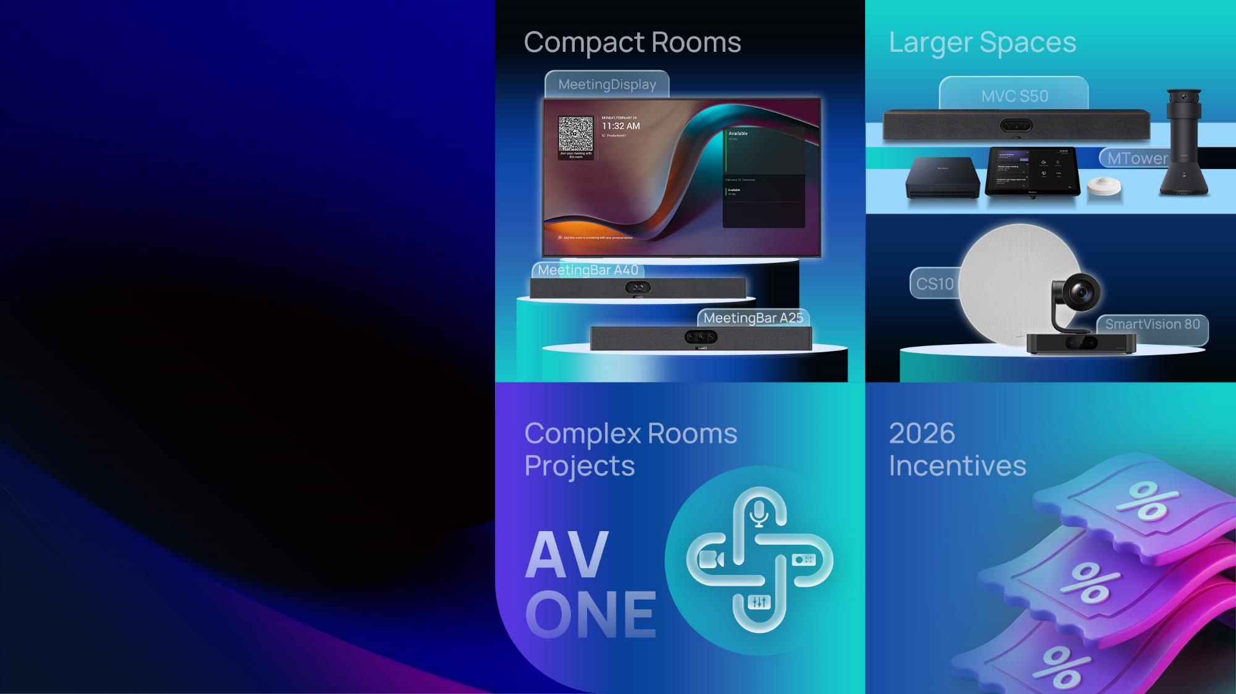
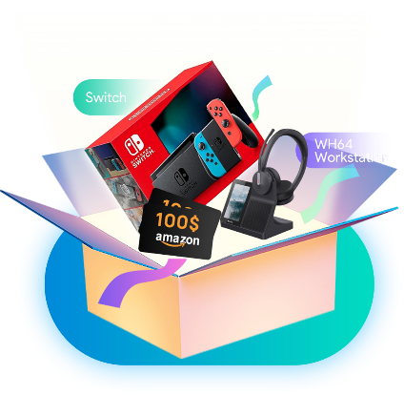
Unlock the Next Meeting Opportunities
Notes:
开场白，Elisa自由发挥，介绍自己，并简单说一下本场演讲的内容，主要分为2大部分，

Slide 2

Our 2025
10-Year Strategic
Partnership with Microsoft
Major Product Launch:
over 10 New Product Updates Across the Portfolio
Full Operation of Singapore Global Operational Headquarters
Middle East Data
Center Launch (UAE)
Notes:
开头可以先跟大家聊一下我们2025的成就，包括微软合作10周年，超过10个新品上市，新加坡运营中心正式投入运营，新增中东数据中心
Before we get into 2026’s trends and opportunities, let’s take a quick look at Yealink’s big wins last year.
We extended our 10-year strategic partnership with Microsoft, launched over 10 new products across our portfolio, opened a data center in the UAE for the Middle East, and our Singapore global HQ is now fully operational. These achievements mean we’re better positioned than ever to support your meeting business in 2026—with the backing of trusted partners like [Guest Name] and Microsoft.

Slide 3
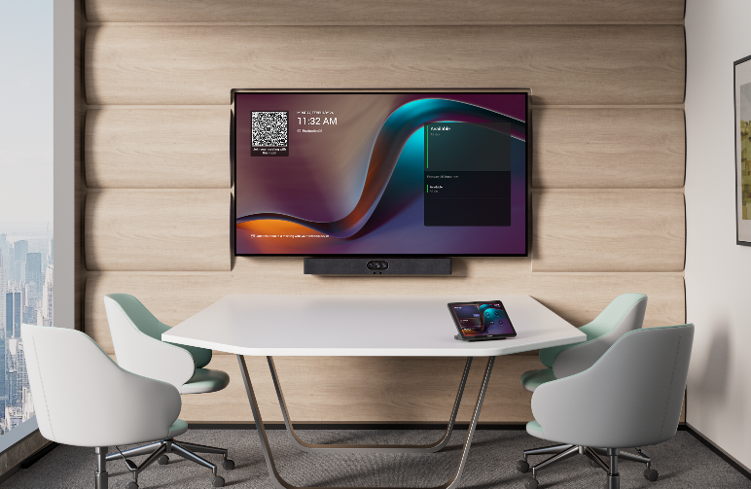
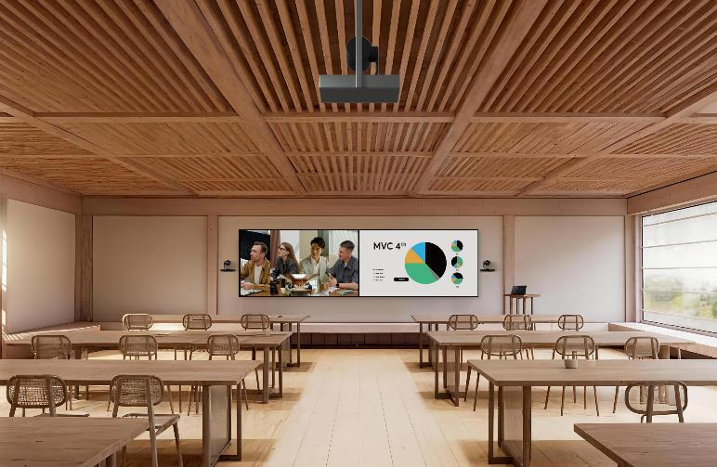
2026 New Meeting Market Trends
The Meeting Room Market Is Splitting
Huddle rooms
ProAV rooms
Whole VC Market: $41.6B (2025) → $65.7B (2034) | CAGR 5.90%
Source: Fortune Business Insights 2026
Notes:
the first big shift is that the meeting room market is splitting—and growing fast. As we can tell from the numbers, this market is splitting into two core segments: huddle rooms for 2-4 people, and ProAV rooms for 10+ people like training rooms and boardrooms.
And the biggest opportunity for you is right in between these two segments.

Slide 4

2026 New Meeting Market Trends
Bigger Opportunities Than Ever
Emerging Opportunities
GROWTH
45%
of video conferencing hardware market is driven by huddle rooms.
(Source: Mordor Intelligence)
VALUE
Higher value, longer cycles,
more profitable long-term partnerships
Room Size
Hunndle Rooms
Standard Rooms
High-End & Complex Room
Notes:
Standard meeting rooms — like small rooms and medium rooms — are already quite mature. The solutions are well established, and the growth has gradually stabilized. So where is the next opportunity?
First, huddle rooms. In fact, 45% of the video conferencing hardware market is driven by huddle rooms. Second, high-end and complex rooms. These projects usually come with higher value, longer
cycles, and more profitable long-term partnerships. Every segment has a clear opportunity, and Yealink has solutions for all of them.

Slide 5








2026 New Meeting Market Trends
Requirements Are Splitting Too
Small Room
Pro Room
Great experience
Plug & play
RESELLER/
RESELLER
PROFIT
Easy deployment
AI-powered
Cost-effective
Fast install
Immersive
Custom integration
Notes:
We should notice that customers’ requirements are splitting too. For small rooms, customers care about 4 things: great experience, plug-and-play simplicity, cost-effective, and fast installation. For Pro AV rooms, it’s all about easy deployment, AI-powered features, immersive experiences, and custom integration.
The better you match these requirements with the right product, the higher your partner profit.

Slide 6

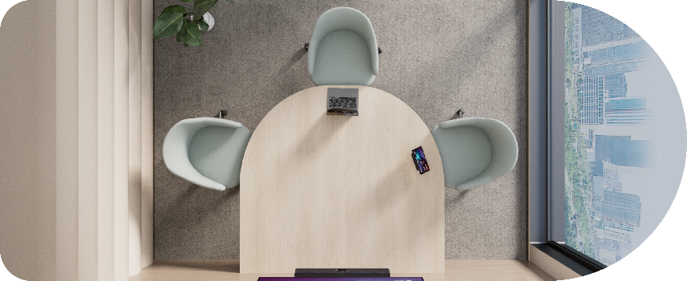
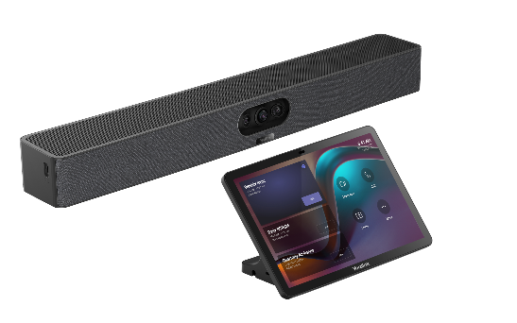
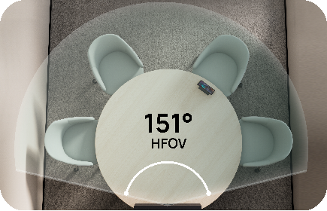
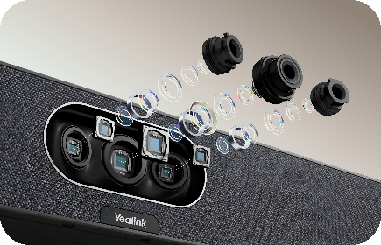

Purpose-Built for Small Spaces – MeetingBar A25
A25
151° HFOV Ultra-Wide Optics
Triple 4K Lens System
Full-Duplex Acoustic Engine
Keeps everyone in frame with a wide FOV built for table-against-wall compact meeting setups.
Compared with a 180° stitched view, A25's 1 ultra-wide + 2 telephoto lenses coordinate intelligently for sharper, edge-to-edge clarity.
Participants can talk freely from both ends — no awkward pauses, no lost ideas.
Notes:
So, for the fast-growing small room segment, we have the MeetingBar A25—purpose-built for compact spaces. Let’s hit the key features: 151° ultra-wide FOV to keep everyone

Slide 7

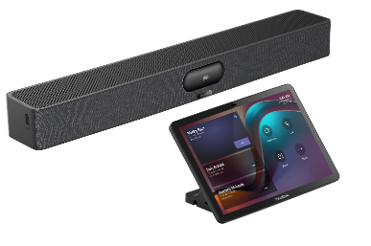
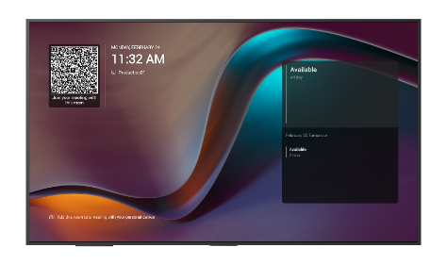
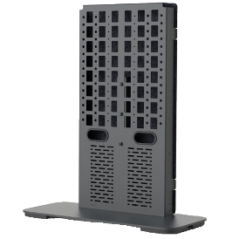
Express Install: Deploy Fast. Scale Faster.
NEW
A25-031
MeetingDisplay 55
Heckler - H1090-CAST
Quick & Easy Deployment — Streamline installation with user-friendly setup tools.
Unified & Seamless Integration — MeetingDisplay 55 matches perfectly with A25.
Automatic source switching, digital signage support, and complete control with one touch console.
MeetingDisplay 55 - Global GA expected by the end of May.
Notes:
And the A25 isn’t just a standalone product—we’ve designed it for express install: deploy fast, scale faster for your business. Pair the A25 with our new MeetingDisplay 55 and Heckler, and you get three big wins: quick, user-friendly deployment, seamless integration, and greater productivity for your customers.
Quick update: MeetingDisplay 55 is expected to reach global GA by the end of May.

Slide 8


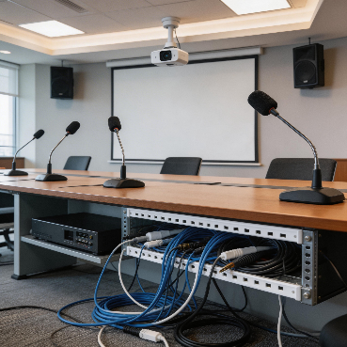
放微软的logo
Expanding into Larger Spaces
Pain Points: Bigger Space, Bigger Problems
Back row can't see
Speakers can't be heard
Deployment complexity
faces, whiteboards, PPTs all blur
sound disperses, echo increases
multi-camera cabling, tuning, compatibility
Notes:
the big opportunities, moving into larger meeting spaces.
These spaces have huge profit potential, but we all know they come with big pain points for customers and for you as resellers.
First, visibility: the back row can’t see—faces, whiteboards, slides all blur. Second, audio: speakers can’t be heard, and echo is a big issue. Third, deployment: multi-camera cabling, tuning, compatibility problems.
No worries, Yealink has a solution that fixes all of these pain points!

Slide 9
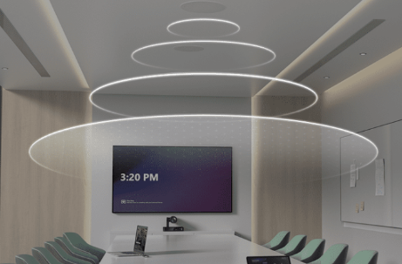
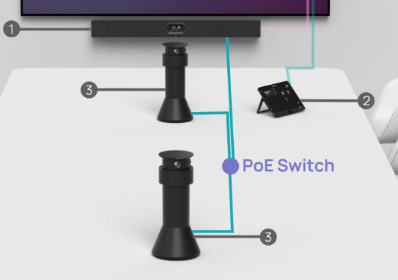

Expanding into Larger Spaces
Meeting the Three Must-Haves.
Must-Have 1
Must-Have 2
Must-Have 3
Everyone visible
Best View Experience（MTower）IntelliFocus + Front/Center Ccamera switching
Everyone heard
Pro-grade pickup + coverage and extended mics
Simple deployment
Plug & play, minimal tuning and Daisy-chain linkage
Notes:
For larger spaces, we’ve identified three non-negotiable must-haves. First: everyone visible. Thanks to MTower’s IntelliFocus and front/center camera switching, every participant is seen clearly. Second: everyone heard, with pro-grade audio pickup, extended mics, and noise cancellation—sound is clear even in big rooms. Third: simple deployment—plug-and-play setup, auto linkage for multiple devices, no complex cabling or tuning.
These three must-haves are the foundation of our larger space solutions, and they make your job easier while surprising your customers.

Slide 10

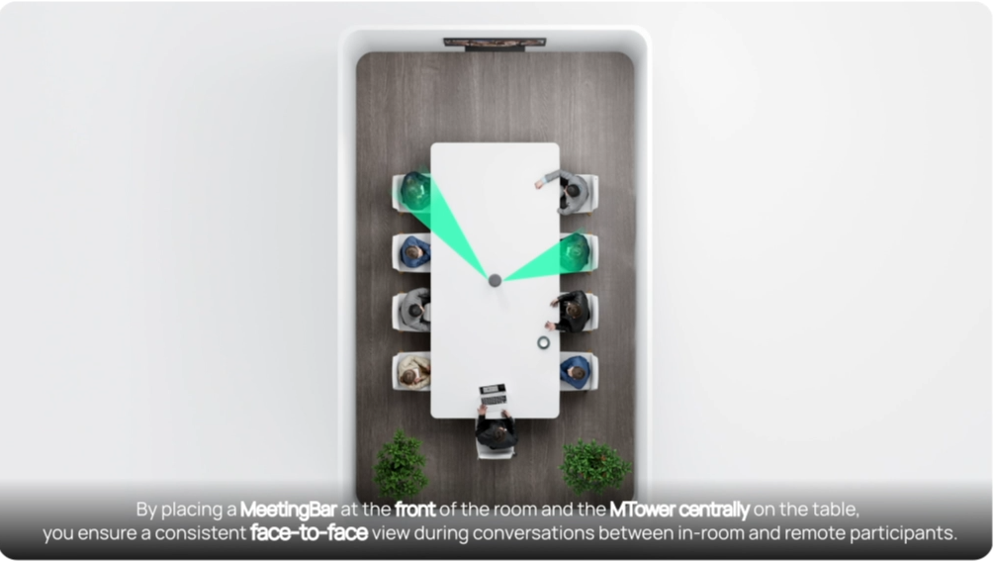
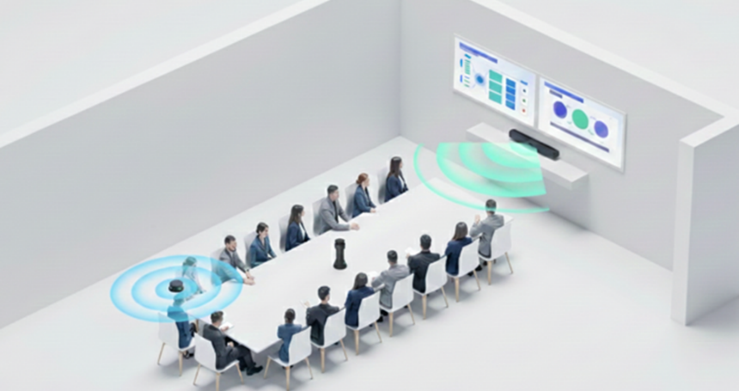
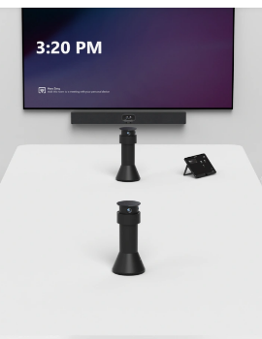
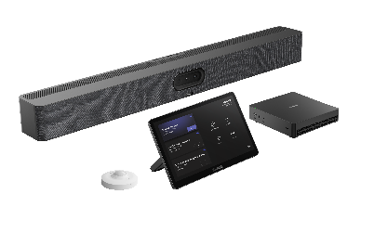
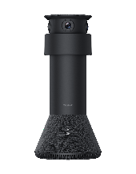
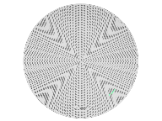
A50 Expansion Kit
Extend cam, mic, sound to Medium to Large room
A50/MVC S50
MTower
A50/MVC S50
CS10 Ceiling Speaker
+
+
By integrating Yealink table camera, the system capture the best view for every participant and extend the audio pick-up area. (Also support 2x MTower in the 26Q2)
By integrating Yealink ceiling speakers, the system ensures balanced sound coverage and consistent audio clarity for all participants throughout the room.（26Q2）
Notes:
The core of our larger space solution is the A50 Expansion Kit. Pair it with MTower, and you get the best view for every participant plus extended audio pickup—we’ll even support two MTowers in Q2 2026 for even bigger spaces.
Pair it with our CS10 Ceiling Speaker, and you get balanced sound coverage across the entire room—CS10 support is coming in Q2 too.
It’s a modular solution, so you can tailor it to your customer’s exact room size.

Slide 11
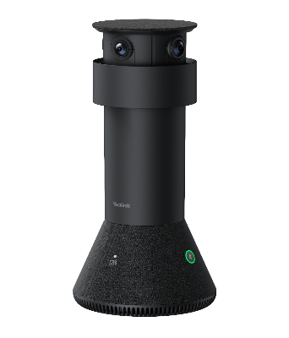
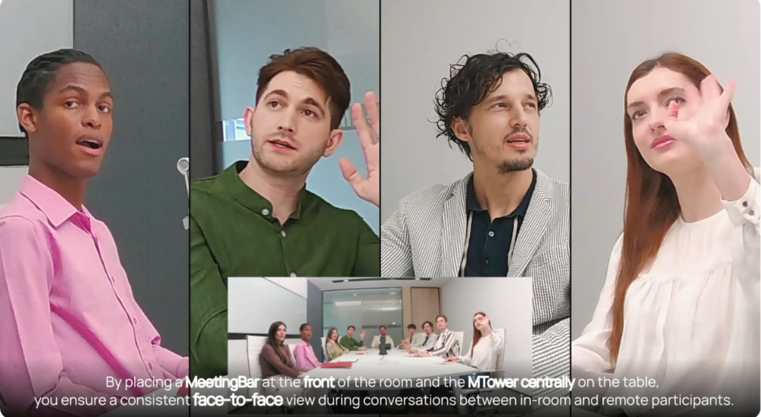
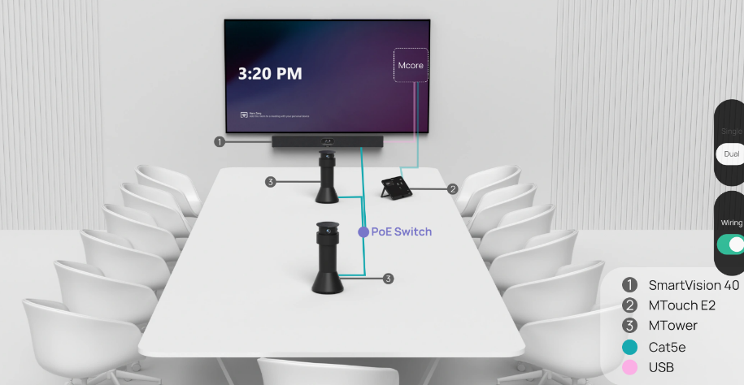
MTower
Unique Front＋Center Experience
incentive
By placing a video conference device at the front of the room and the MTower centrally on the table.
You can discover a smarter meeting environment where you can always show your best side on the screen.
Notes:
Let’s dive a little deeper into MTower—the star of our larger space visual solution, with a unique front-and-center experience that changes how hybrid meetings work. Its AI-powered technology automatically switches to keep every participant in a “front face” view. Whether someone’s speaking from the back of the room or moving around, MTower ensures they’re always clearly seen.
But that’s not all: MTower also supports daisy-chain serial deployment for ultimate simplicity—no messy cables or complex setup. And when paired with our audio solutions, it extends pickup range to cover even the largest rooms.

Slide 12
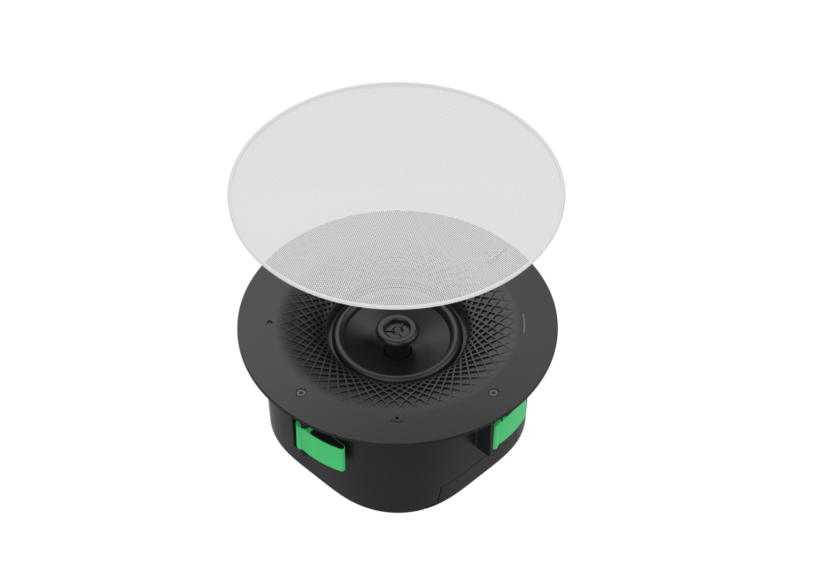
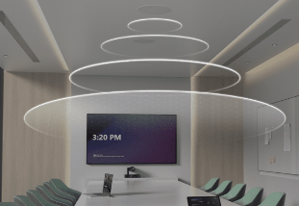

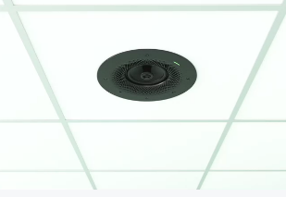
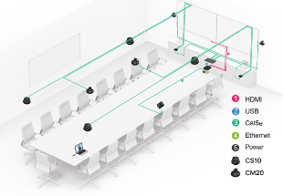
CS10/CS10-D Speaker
2-Way Coaxial Low-Profile Network Speaker
General / Dante version Speaker
2-way coaxial speaker
Designed to fit-in
IEEE802.3at 30W PoE
Notes:
For audio in larger spaces, we have the CS10 and CS10-D Ceiling Speakers—two versions to fit every customer’s needs: a general version for standard setups, and a Dante version for professional AV integrations.
The biggest win for you? One-cable simple deployment. No complicated wiring, no time-consuming setup. It’s easy to install, easy to integrate, and delivers the consistent sound coverage your larger space.

Slide 13


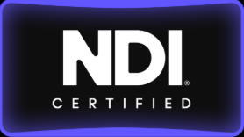
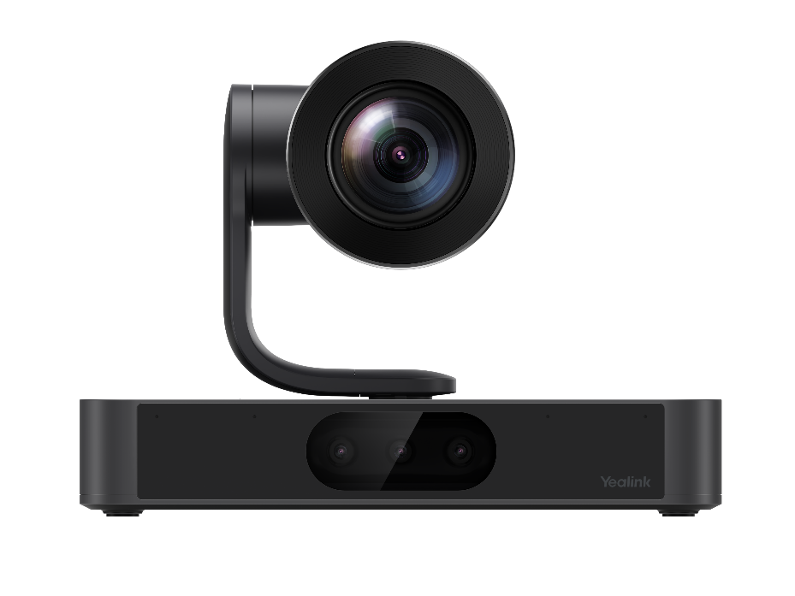
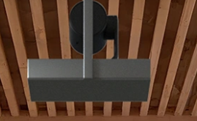
SmartVision80 Updates
放微软的logo
20x Optical Zoom
New Updates
Qualcomm QCS8550 inside
48Tops Computing Power
Triple-eye Camera System
2* tele-photo lens + 1* wide-angle lens
NDI | HX3, Dante compatible
Built-in 4-Mic Array
Can be ceiling mounted
Notes:
Next up, our flagship camera for high-end spaces: SmartVision80 with big new updates—stay tuned for the live demo in just a minute!
Let’s hit the key upgrades: it’s now NDI certified, ceiling mountable for flexible setup, has a built-in 4-mic array for audio convenience, and 20x optical zoom for crystal-clear views from 15-20 meters away. It’s NDI|HX3 and Dante compatible—an all-in-one camera for high-end complex rooms.

Slide 14

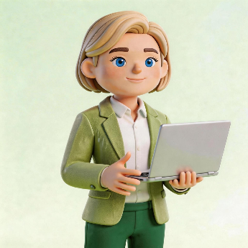
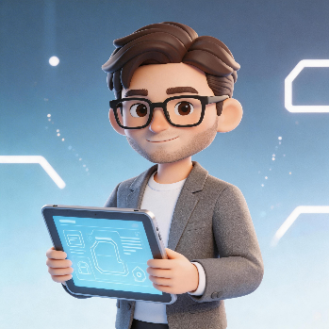
放微软的logo
Moving into High-End & Complex Room Projects
Who's Using It? — 3 Profiles of Decision-Makers
Board Members
Executive Team
IT Decision Makers
Experience, image quality, reliability
efficiency, collaboration, AI assistance
compatibility, manageability, future-proof.
Notes:
Now, let’s shift to high-end & complex room projects—the highest profit segment for resellers, but also the hardest to win.
The key to winning these deals is to understand who the decision-makers are and what they care about.
Board Members—they care about meeting experience, brand image, and reliable performance.
Executive Teams—efficiency, cross-team collaboration, and AI-powered features to save time.
IT Decision Makers—compatibility with existing systems, easy to manage, and future-proof.

Slide 15


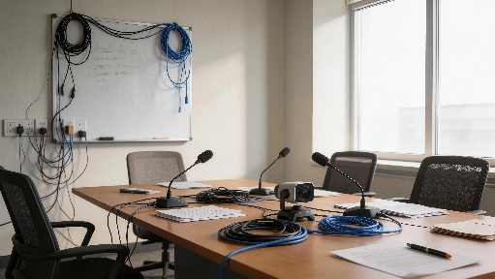
Moving into High-End & Complex Room Projects
Why High-End Projects Are Hard to Win?
Too many parts. Too many problems.
High expectations — Customers have seen it all
Complex integration — Multiple systems, brands, controls
High delivery cost — Customization, long tuning cycles
Notes:
That's why high-end projects are hard to win.
There's high customer expectations—they’ve seen the best, so you can’t cut corners. The integration is also very complicated—multiple systems, multiple brands, multiple controls—compatibility issues are a given. Then, high delivery costs, this eats into your profit and leads to delays.
For years, this has been the status for ProAV projects—but Yealink is changing that with our AV ONE solution: one vendor, one network, one software.

Slide 16
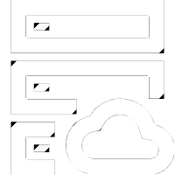
Yealink AV ONE
One Vendor
One Network
One Software
Notes:
Introducing Yealink AV ONE—our all-in-one ProAV solution for high-end complex rooms, built to solve the pain points we just talked about, with one simple promise: one vendor, one network, one software.

Slide 17
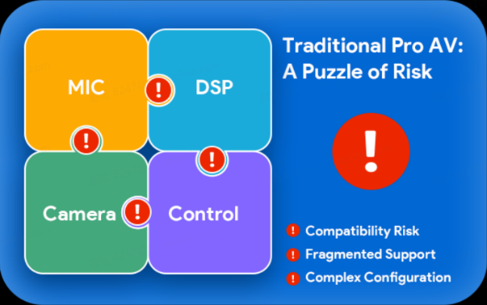
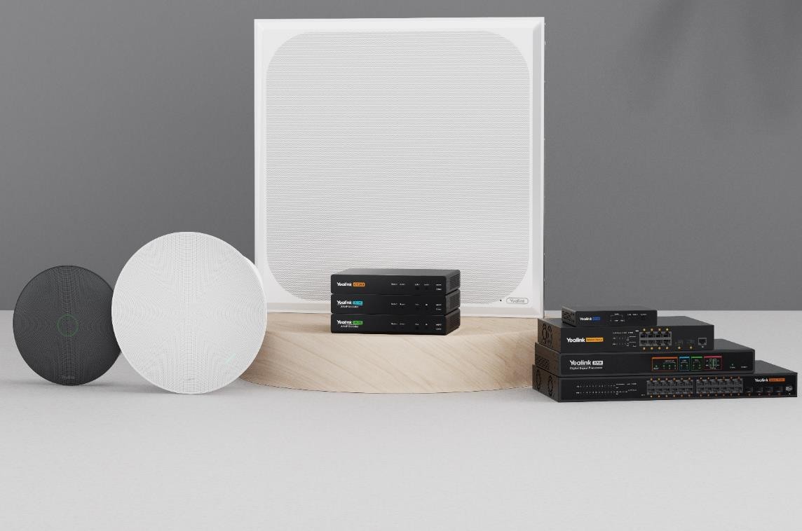
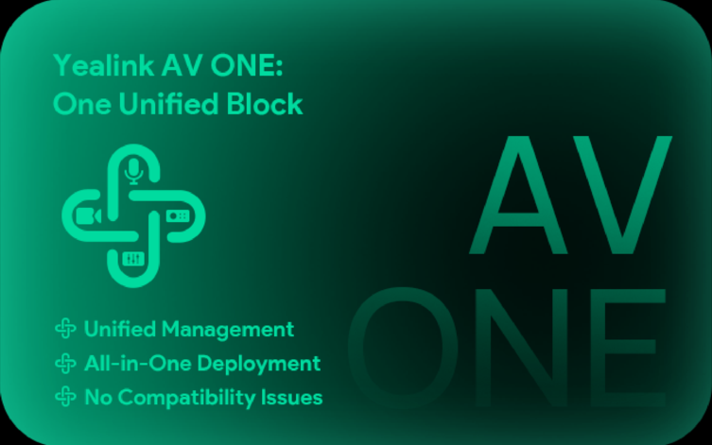




Moving into High-End & High-Value Room Projects
ProAV Solution: AV ONE
Comprehensive
One-Stop AV Solution
Effortless Deployment with
Automated Smart Design
Tailored for Video
Conferencing
Flexible and Standards-based
AVoIP Deployment
Notes:
Let’s compare it to traditional solutions: traditional solutions are a puzzle of risk—compatibility issues, fragmented support (you have to call 5 different vendors for help), and complex configuration.
And AV ONE is a single unified block. This means less work for you, lower delivery costs, and higher profits on every high-end project.
The result? You get a comprehensive one-stop AV solution—cameras, audio, control, all from Yealink; effortless deployment with automated smart design—so you save time on planning and installation; tailored for video conferencing; and flexible AVoIP deployment—standards-based, so it integrates with existing AVoIP systems if needed.

Slide 18
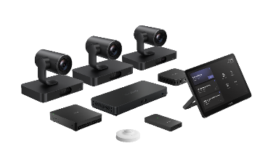
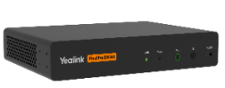






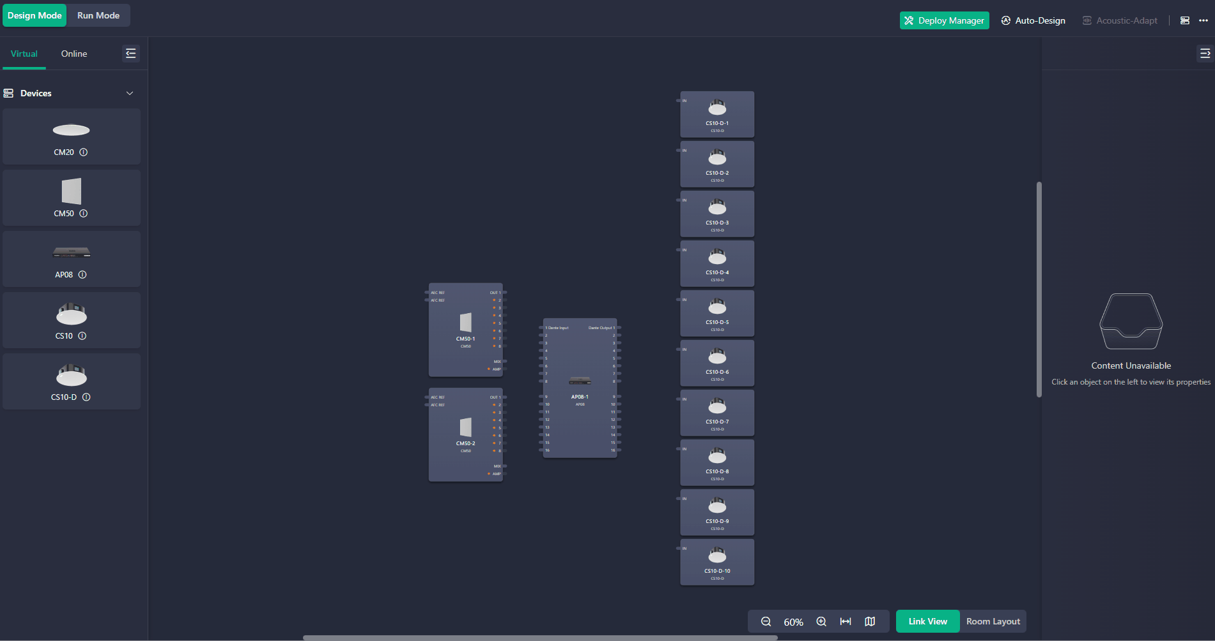
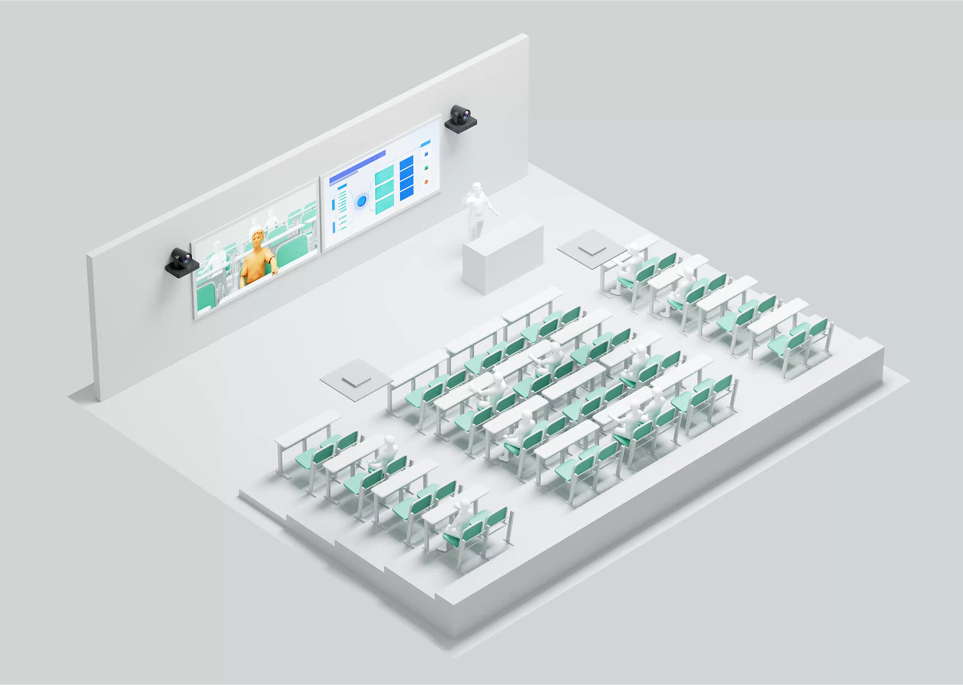
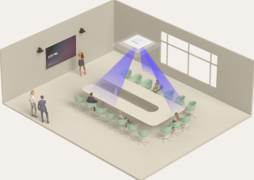
Yealink AV ONE SMART ROOM Solution
Multi Camera Solution
Ceiling Audio Solution
AVoIP Encoder & Decoder
STANDARD-CM20 audio solution
CM20
CS10
AVHUB
AVoIP Encoder/Decode – EN300/DE300
PREMIUM-CM50 audio solution
MVC S98
CM50
CS10-D
AP08
Controller - CT200
Intelligent Design and deployment tool for video and audio solutions.
Mic-driven Camera Tracking: precisely frames the active speaker.
Yealink Room Designer
Training Room
Board Room
Future-proof performance Automatic deployment design Easy to manage and maintain
Notes:
Inside AV ONE solution, there are flexible multi-camera solutions, audio options and AVoIP solutions for every budget.
It’s scalable—you can upgrade from standard to premium as your customer’s needs grow, giving you recurring revenue opportunities.
Worth mentioning Yealink Room Designer here—our intelligent design and deployment tool.
Here’s how it works: it has a design mode and run mode—you input the room size, and the tool does automatic deployment design.
It also has Acoustic-Adapt for perfect audio tuning, and it’s built for future-proof performance—easily add new devices later.

Slide 19
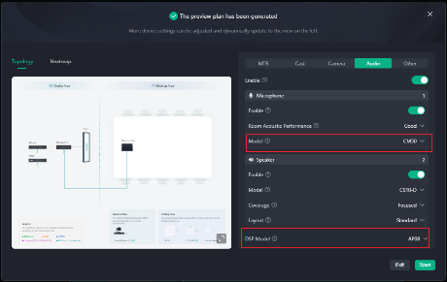
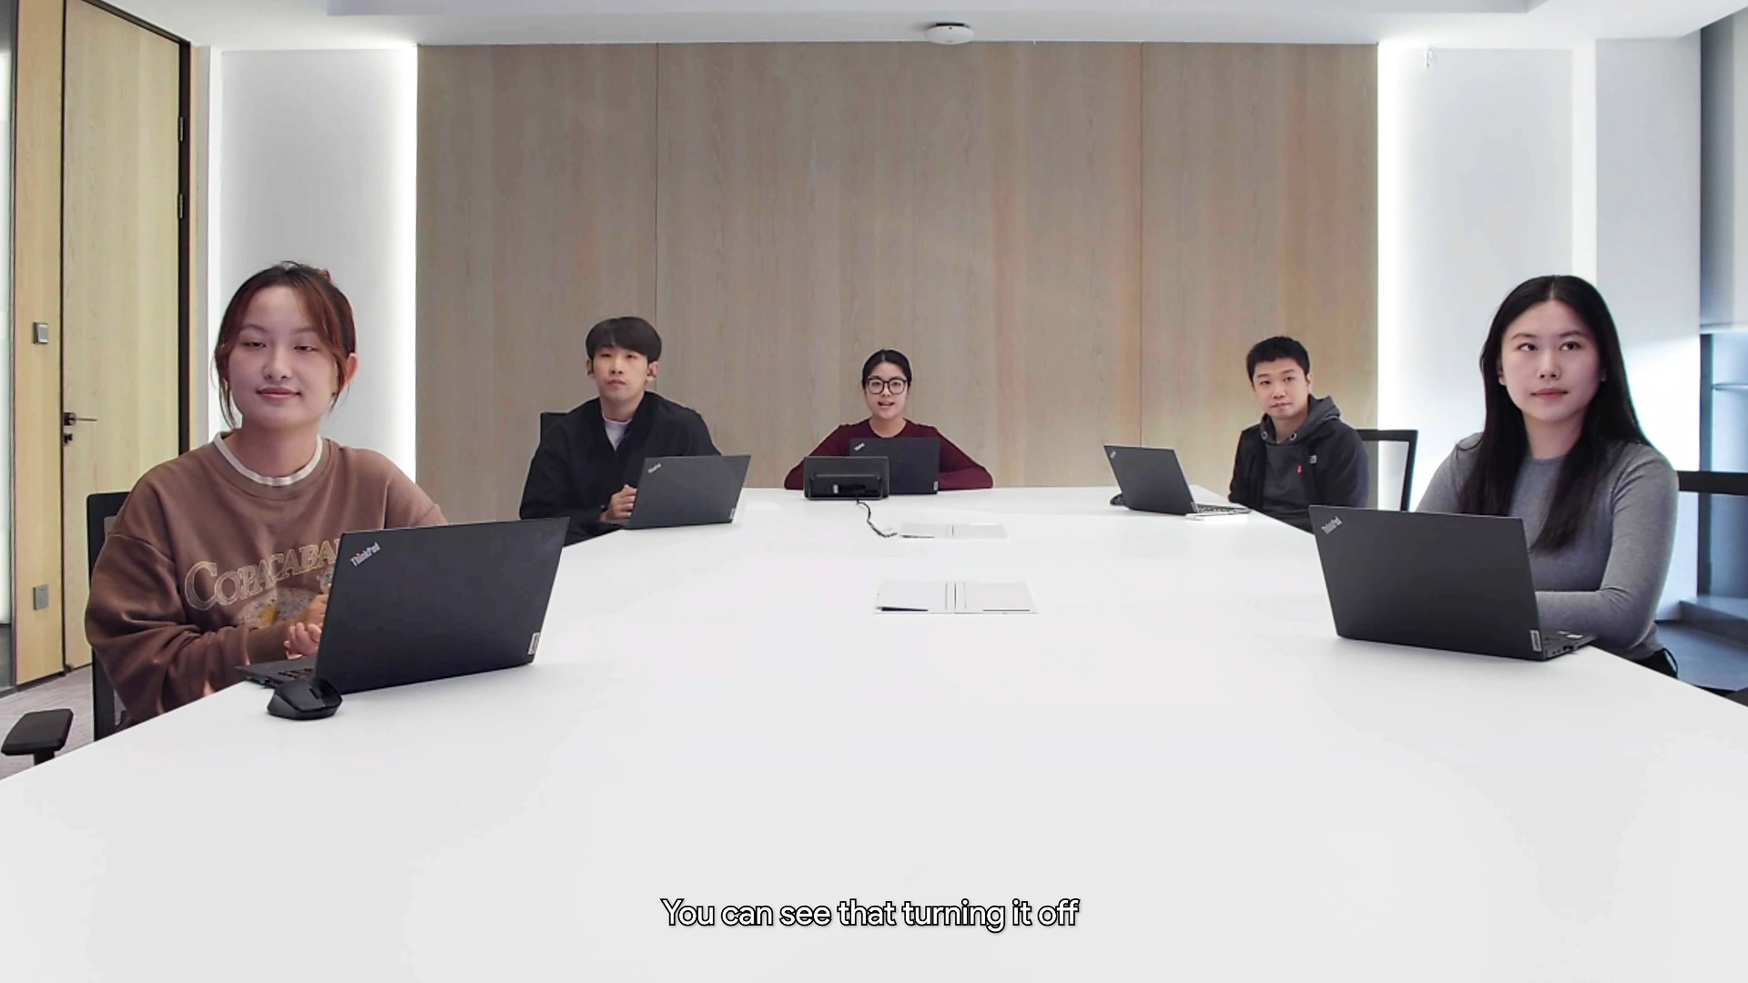
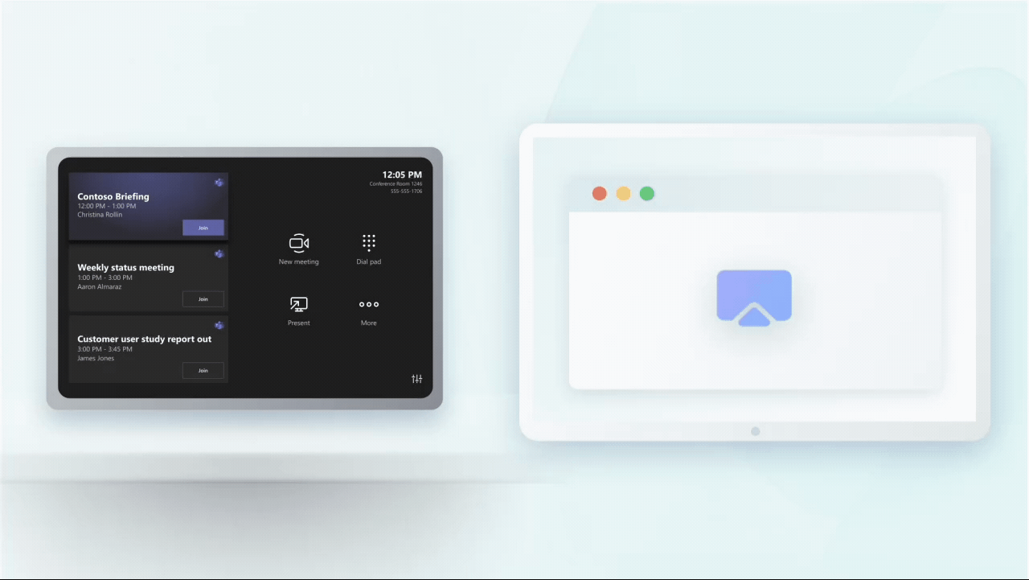
放微软的logo
Intelligent Linkage · Zero Config
Three Things to Know
1. Auto Design — Room Designer plans your solution. One vendor, one experience.
2. Zero Config Linkage — Mic finds speaker. Camera follows. No setup needed.
3. Auto Switch — Camera Tracking: Room view ↔ Speaker view ↔ Presentation mode. Automatically.
Source Switch: Intelligent A/V routing for local and video meetings.
Zero configuration
Auto Switch
Intelligent A/V switching
Automatically completes device connections and configuration.
Ceiling microphone drives precise speaker tracking.
Deep integration with Teams Room, Auto A/V Routing Switching for Local & Video Meetings
Notes:
The result of AV ONE + Room Designer is our AV ONE Smart Room Solution—the ultimate high-end meeting room experience, with 3 game-changing features for your customers.
First, zero config—devices connect and configure automatically, no manual setup. Second, auto switch—room view, speaker view, presentation mode, all switch automatically. Third, multi-speaker presented (coming soon) for multiple presenters at once.

Slide 20

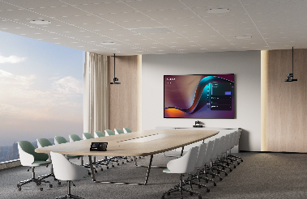
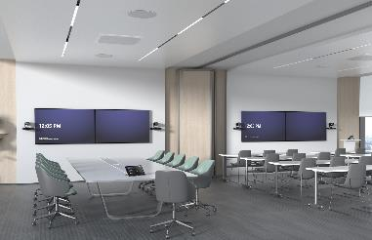
Best Practice
Training Room
Board Room & Large Room
Divisible Room
20-50+, nearly 120m²
10-20, nearly 80m²
Flexible space
· Seamless audio switching between handheld and ceiling microphones
· Auto-tracking cameras follow the active speaker
· Multiple displays ensure perfect visibility for both local and remote attendees
· Crystal-clear audio everywhere with CM50 array + DSP AP08
· Auto speaker layout highlights who's talking
· Perfect for executive meetings and critical discussions
· YPS20 auto-detects room configuration changes
· Audio and cameras adapt instantly to any setup
· No manual adjustments needed
Universal Advantages
Centralized device control via CT200/CT300
Unified Management via the YMCS platform
Notes:
Now, let’s share AV ONE’s best practices for three key high-end room types.
First, boardrooms: seamless audio switching, auto-tracking with CM50 and AP08—perfect for executive meetings. Second, divisible rooms: YPS20 auto-detects room changes, audio/cameras adapt instantly—no manual adjustments. Third, training rooms: AI director for multi-cam tracking, adaptive audio, customizable pickup—ideal for large sessions.
And all room types with CT200/CT300 central control, and YMCS platform unified management.

Slide 21

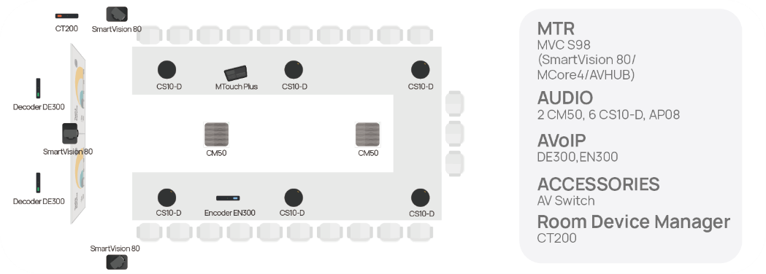
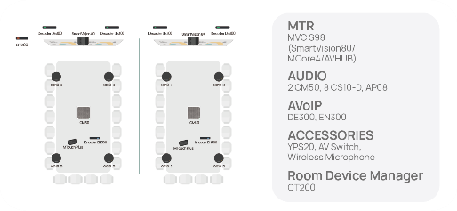
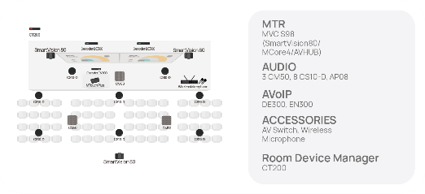
Boardroom
can be stacked
Finally, don't forget — Windows refresh wave is here. Tons of existing meeting rooms need upgrades.
Our Trade-in policy continues from 2025, covering more models. Existing customers become new projects — SIs don't start from zero. That's future-proof.
Divisible room
Training room
Notes:
To make it even easier for you to sell AV ONE, we’ve created pre-built packages for every big room type. No more customizing from scratch—these packages are ready to quote, ready to sell.
And a huge opportunity: Our 2025 trade-in policy is continuing in 2026, with more models covered—existing customers become new projects, so you don’t have to start from zero. This is the perfect time to sell AV ONE to your existing customer base.

Slide 22
AVONE Live Demo
10 mins
Notes:
Now that we've covered so much, let's experience the unique charm of Yealink AVONE together. Our Sales Engineer Doron is already online and ready, and he will bring you a 10-minute live demo.

Slide 23
Thank you

