Slide 1
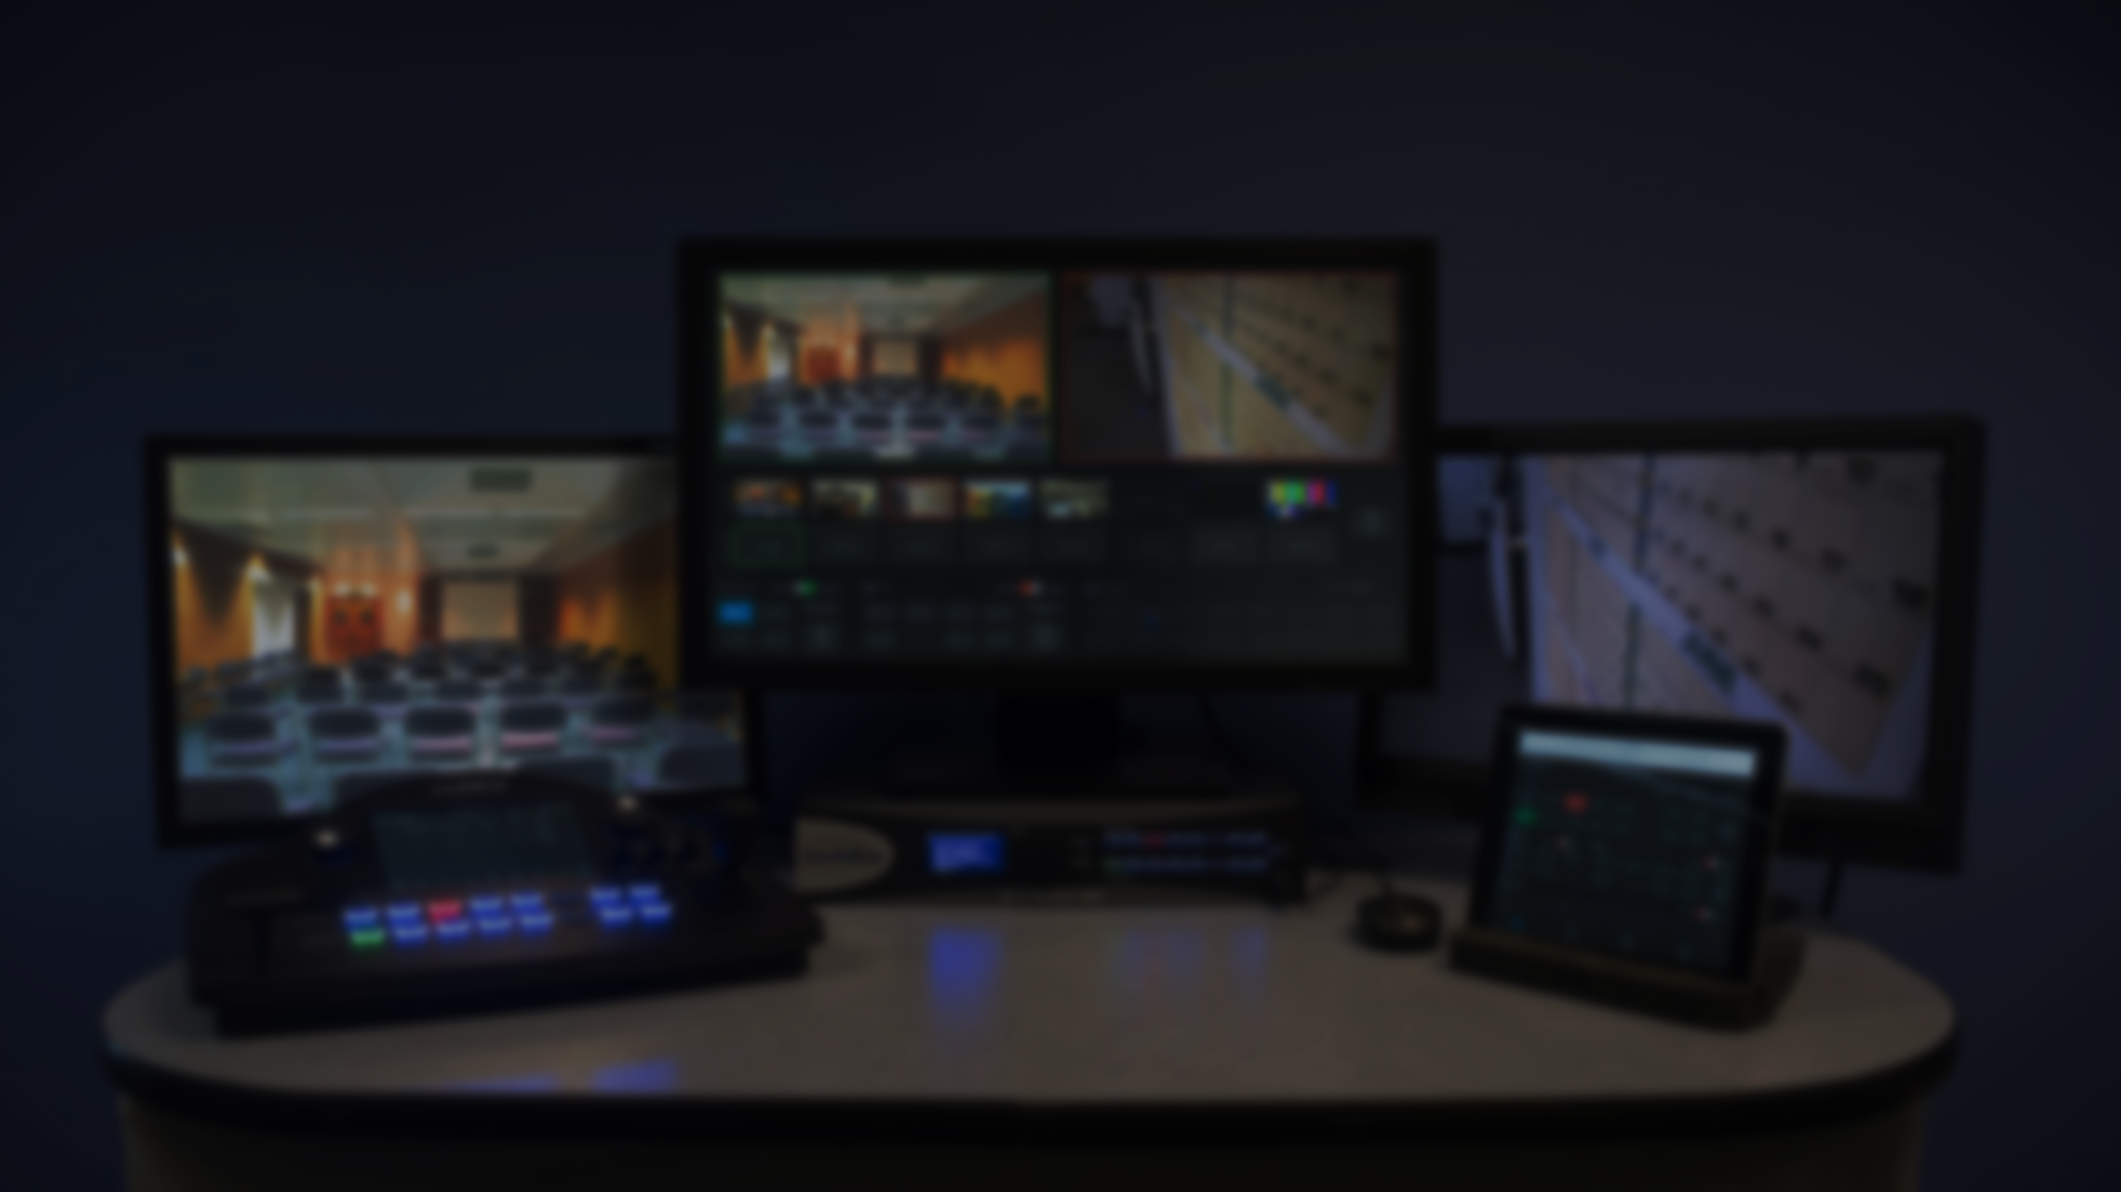

Chief
Professionelle AV- Infrastrukturlösungen
Legrand AV 2026

Slide 2
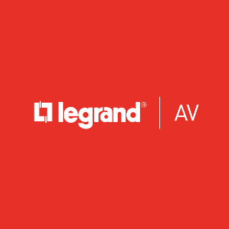

Legrand Group
Worldwide Category Overview
Electrical Wiring Systems
Building Control Systems
Audio / Video
Data Communications
Data Center Power & Control
Lighting
Legrand Gruppe

Slide 3
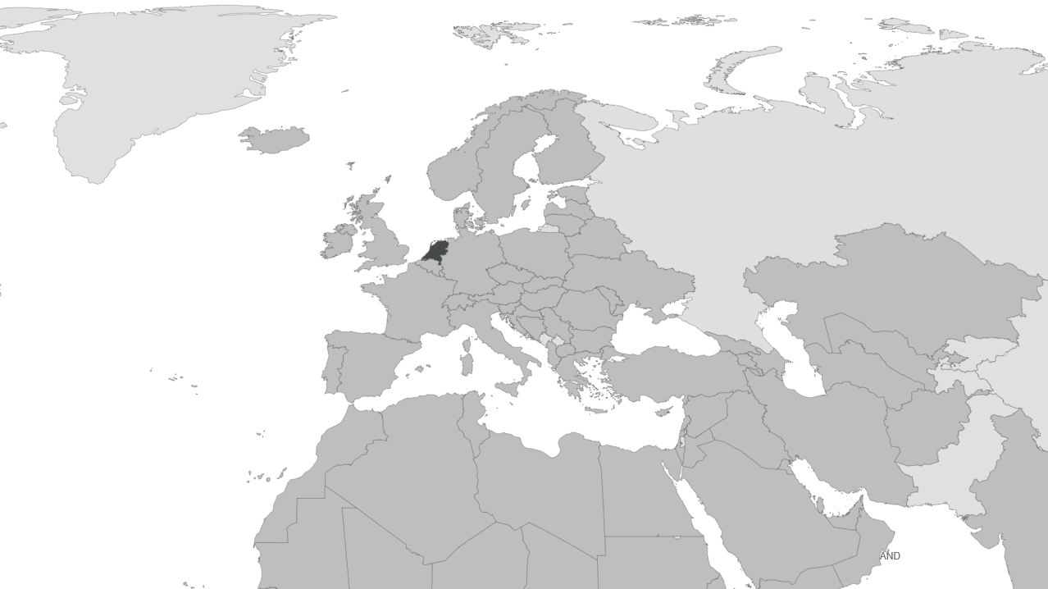
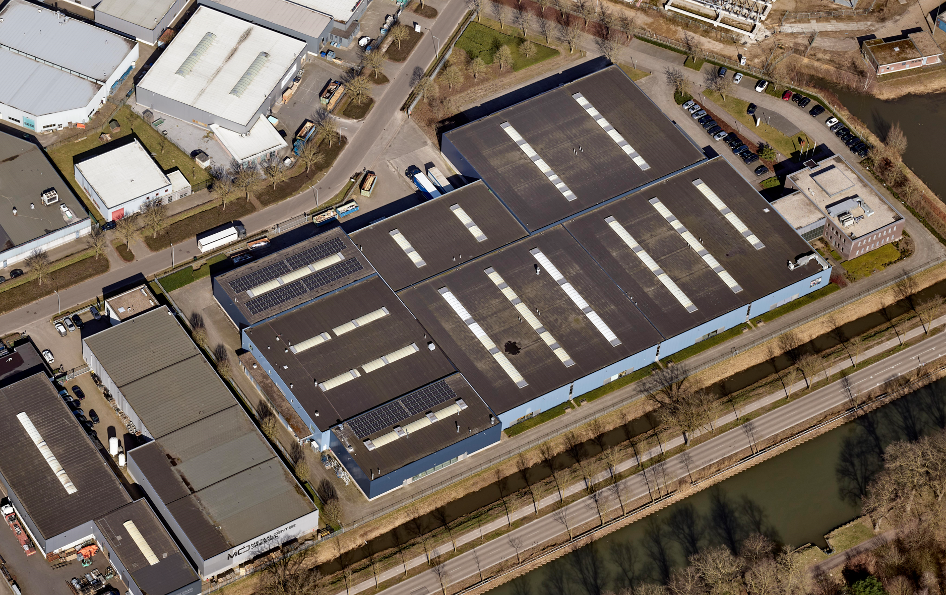
Legrand AV | EMEA
Weert, Netherlands
Responsible for Europe, Middle East and Africa
PROPRIETARY & CONFIDENTIAL // PRODUCT LINE, DIVISION OR BUSINESS UNIT

Slide 4
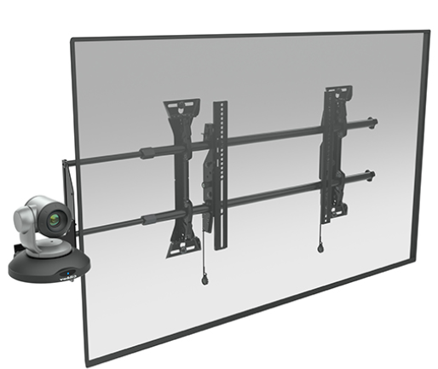
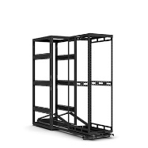
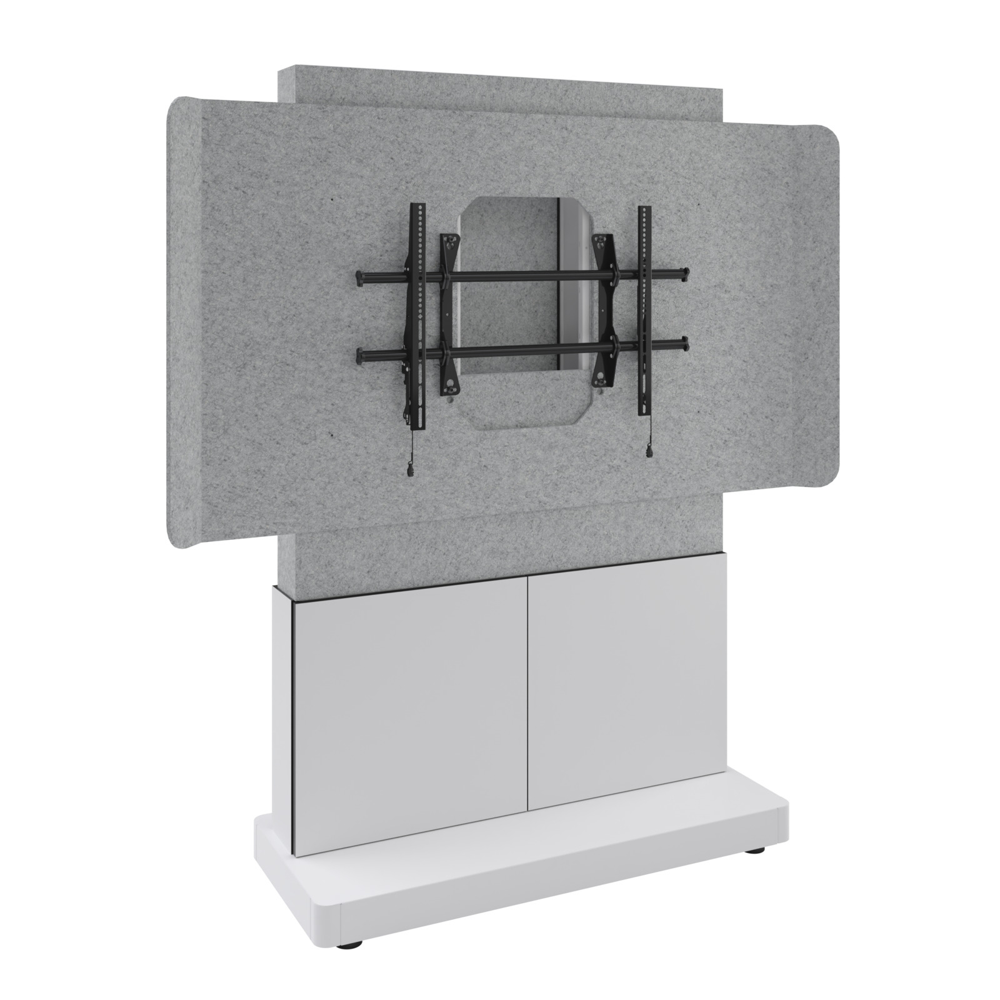
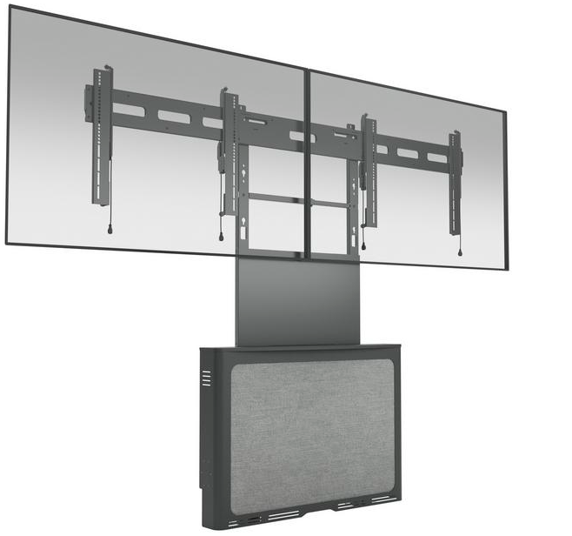
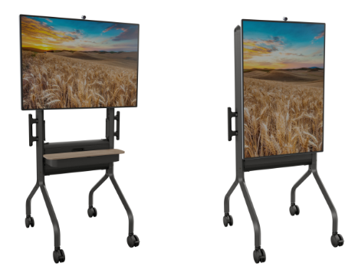

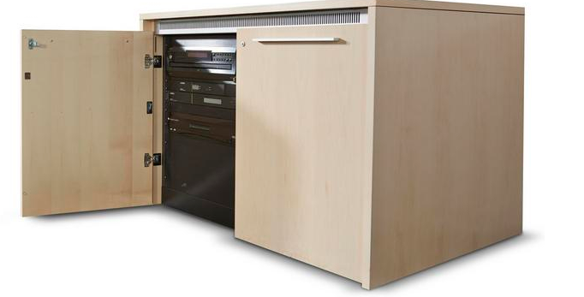
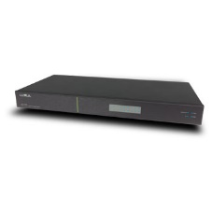
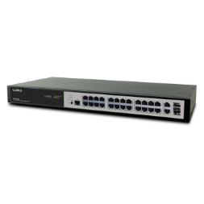

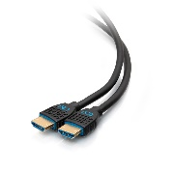
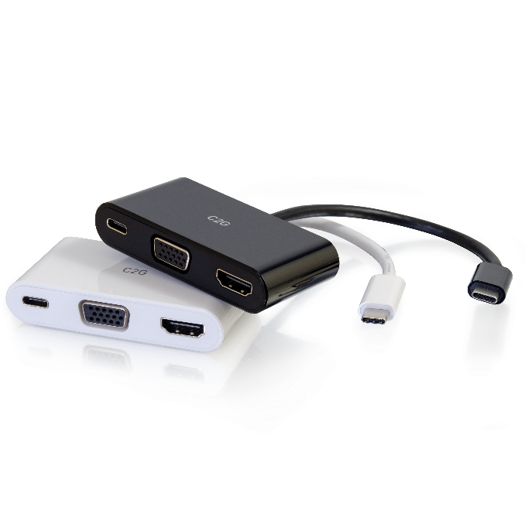
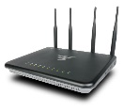
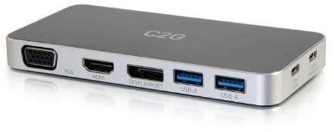


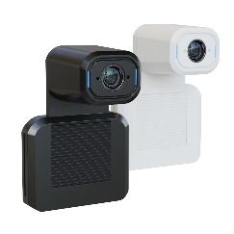
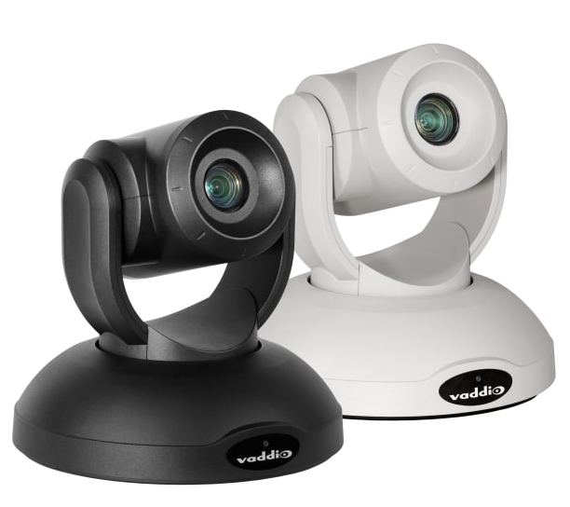
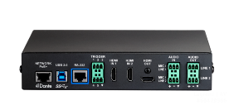
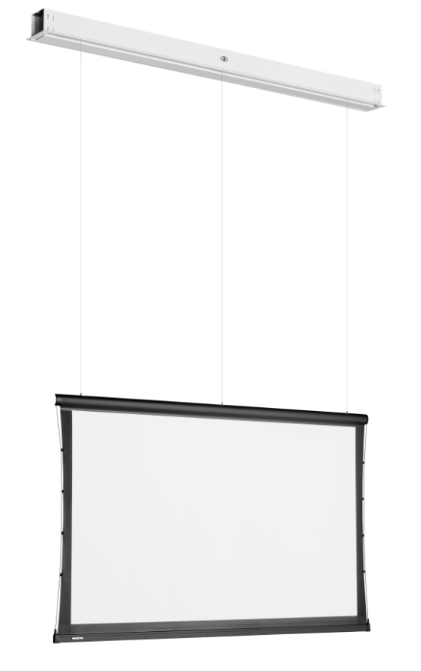
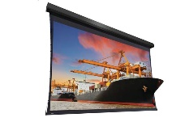
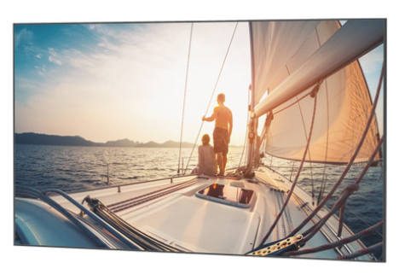
EMEA Brand Overview
AV MOUNTING SOLUTIONS
19” RACK I STORAGE I FURNITURE
SWITCHES I WIRELESS I ROUTERS
CABLES I ADAPTERS I CONNECTIVITY
PTZ CAMERA I AUDIO & VIDEO SOLUTIONS
PROJECTION SCREEN SOLUTIONS

Slide 5
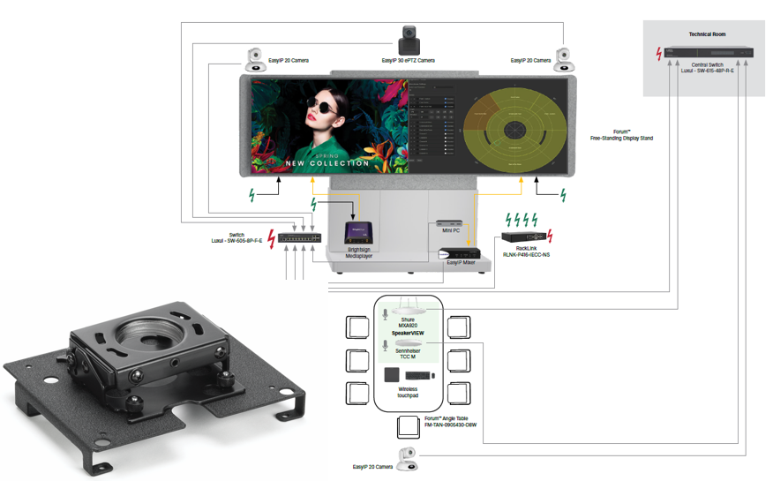
Cross Selling = CHIEF + Vaddio Speaker view + Shure + Sennheiser
Chief Fusion™ | Vaddio | MAP – Cross Selling

Slide 6

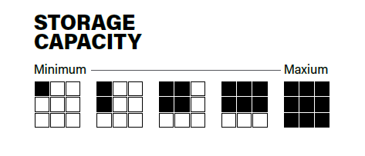
Our Storage Solutions Serie
Wir bieten Ihnen Lösungen für jeden Speicherbedarf
Notes:
Large conventional AV racks are becoming less and less common in professional AV environments like education, corporate, and government settings, as you probably know, this has several reasons:
Decentralization of Equipment: Modern AV setups tend to distribute equipment closer to the end users or display points, minimizing the need for large centralized racks.
Integration and Compact Devices: Advances in device integration have led to smaller, more capable equipment that doesn't require traditional rack mounting. Conference systems, wireless presentation solutions, and compact signal processors are often designed for tabletop or wall-mounting.
Ease of Installation and Maintenance: Smaller, modular, and networked devices are easier to install, upgrade, and troubleshoot compared to large racks. This can reduce installation costs and downtime.
Aesthetic and Space Considerations: Modern environments favor cleaner aesthetics and more flexible space utilization, which often leads to the minimization or elimination of bulky racks.
Emergence of All-in-One Solutions: Many vendors offer all-in-one displays, sound systems, and control units, reducing the need for multiple separate components stored in racks.
Overall, the trend is toward more flexible, space-efficient, and easily managed AV solutions that diminish the reliance on traditional rack-mounted hardware. It is only logical that we are shifting the design of our products towards this new trend.
In case you only need little space behind a display for your media player or power supply, or you need room for an MTR system, up to a full setup with network equipment AV bridges and audio DSP, we got you covered in all levels of storage capacity.
As you can see on the bottom right of this slide, we have solutions from minimum space to maximum space, I’d like to start with the minimal storage solutions:

Slide 7
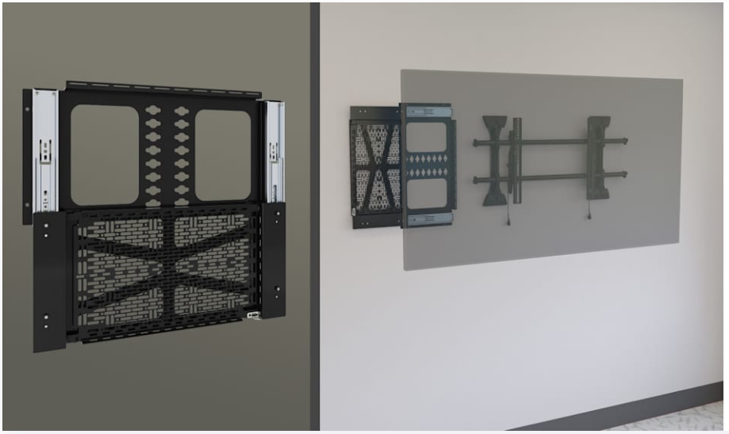
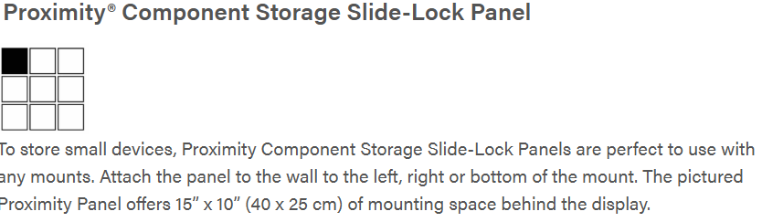
Storage Solutions

Slide 8
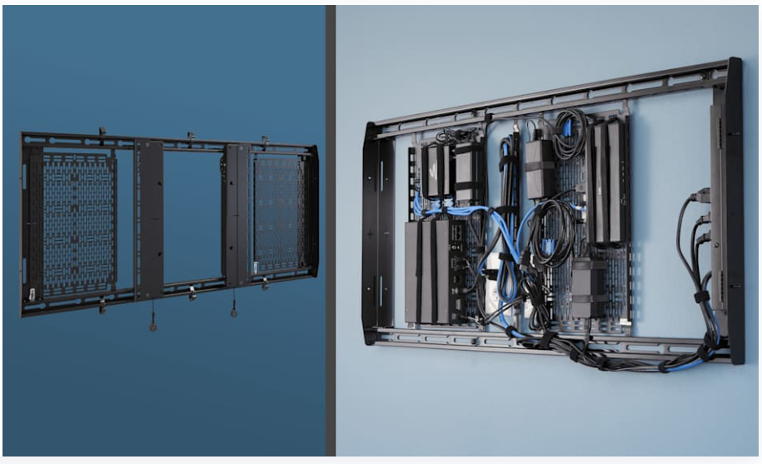
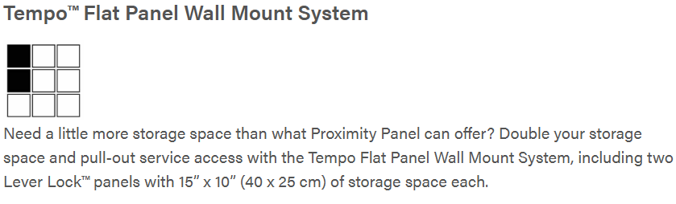
Storage Solutions

Slide 9
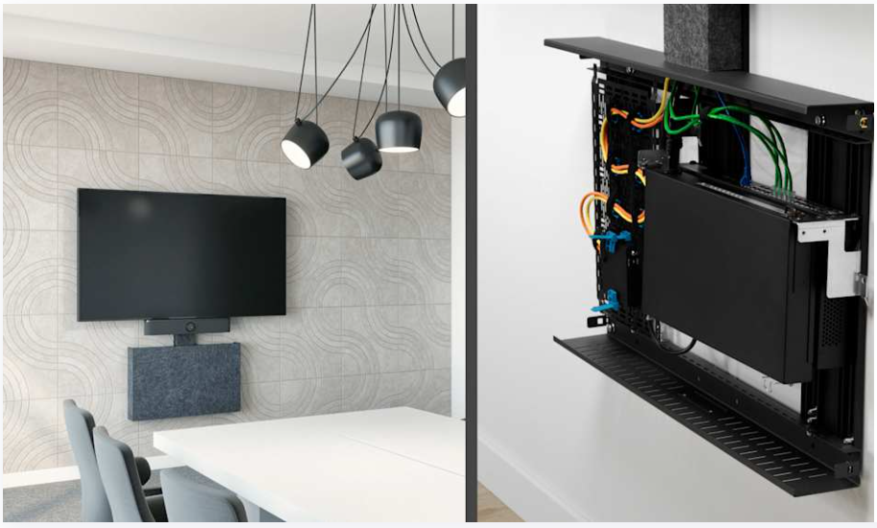
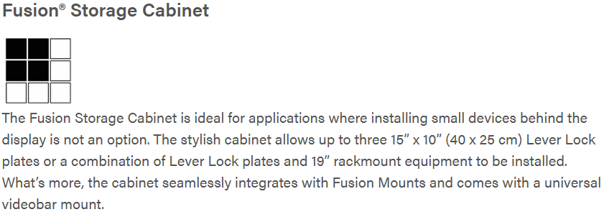
Storage Solutions

Slide 10
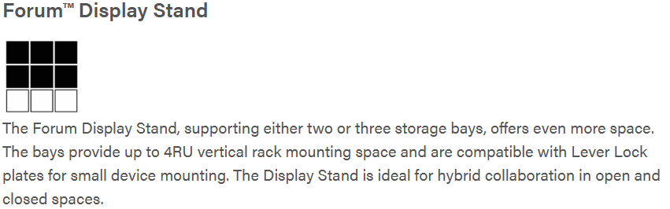

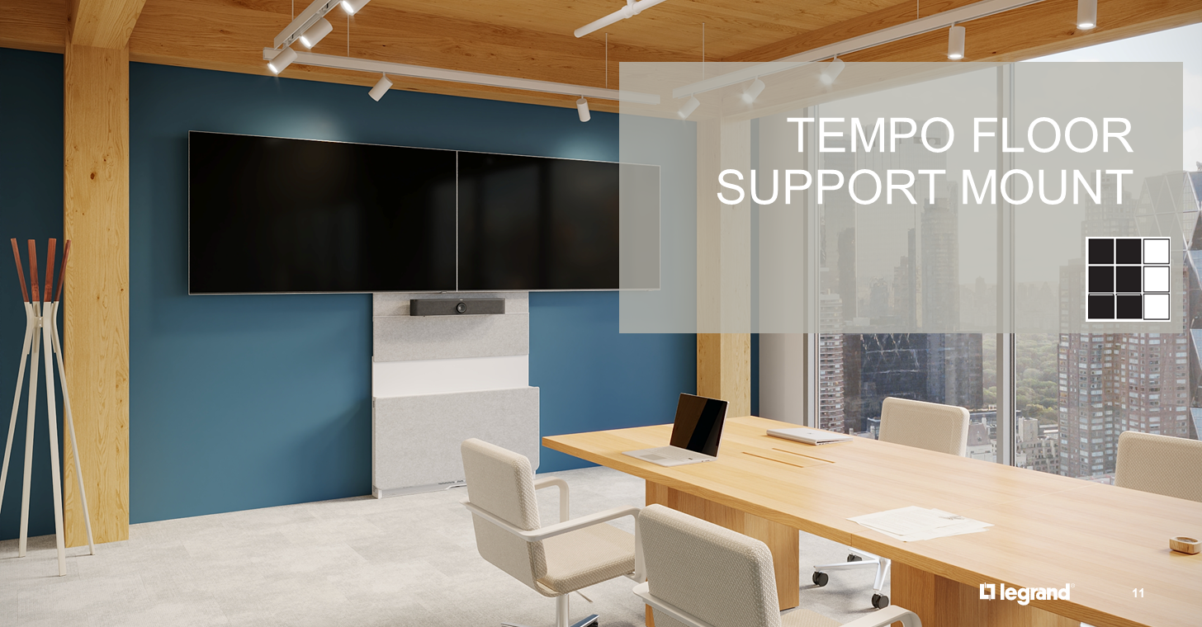
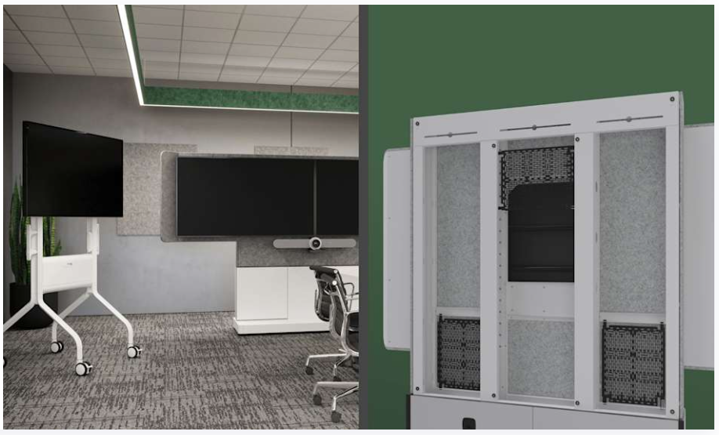
CHIEF Tempo Floor Mount
New!

Slide 11
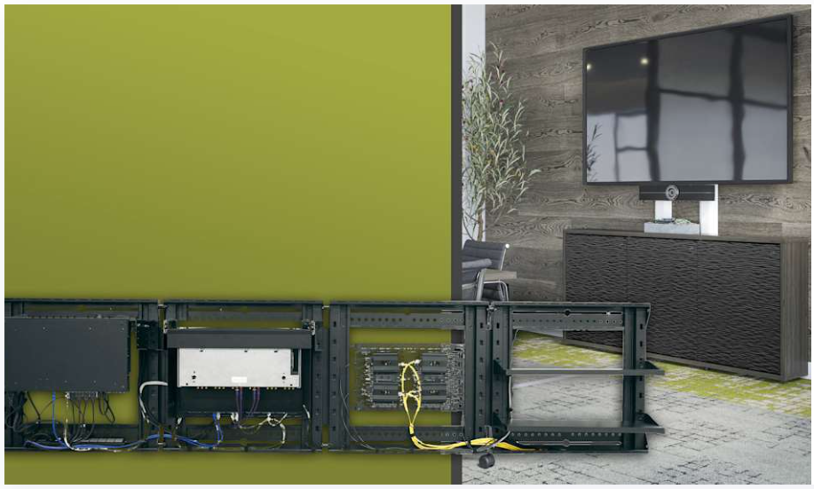
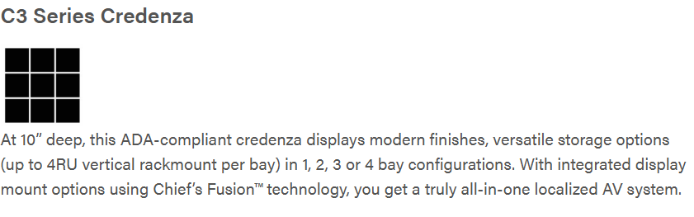
Storage Solutions

Slide 12
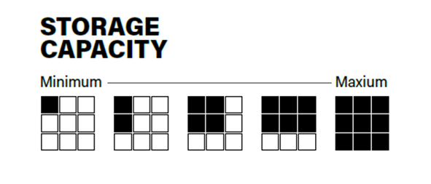
Our Storage Solutions Serie…
…was bedeutet das nun fuer den einzelnen System Integrator?

Slide 13
Arbeitsvorbereitung
Vorkonfiguration aller Komponenten
Definition von Installationsschritten
Erstellung von Installationsplänen & Dokumentation
Material- und Logistikplanung
Reduzierung von Fehlerquellen
Standardisierte Verkabelung und Beschriftung
Getestete Systeme statt Einzelmontage vor Ort
Klare Installationsprozesse
Minimierung menschlicher Fehler

Slide 14
Vorteile auf der Baustelle
Deutlich reduzierte Installationszeit
Weniger Personal vor Ort erforderlich
Schnelle Inbetriebnahme
Geringere Störung des laufenden Betriebs
Qualität & Konsistenz
Gleichbleibende Qualität durch Vorfertigung
Weniger Abweichungen zwischen Standorten
Dokumentierte und geprüfte Systeme
Höhere Kundenzufriedenheit
Hohe Qualität durch Standardisierung (Weltweit)
Ideal für große Rollout-Projekte

Slide 15
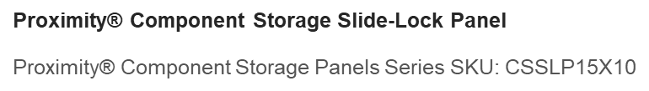

Small Device storage

Slide 16
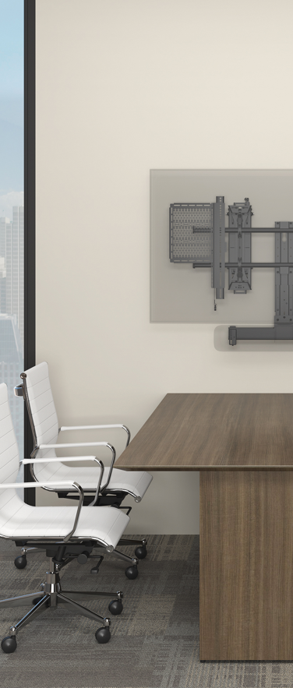
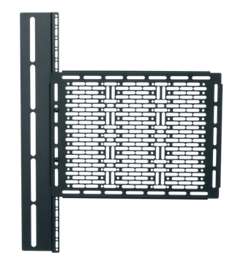
Small device storage solutions
  Proximity™ Component Storage Panel, Interface
  Chief part code: CSMP9X12
  Storage panel 23 cm x 30 cm
  Installs directly into display vesa mounting holes in between display and mount interface

Slide 17
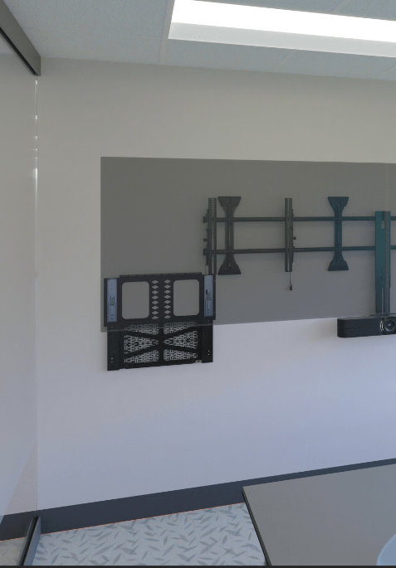
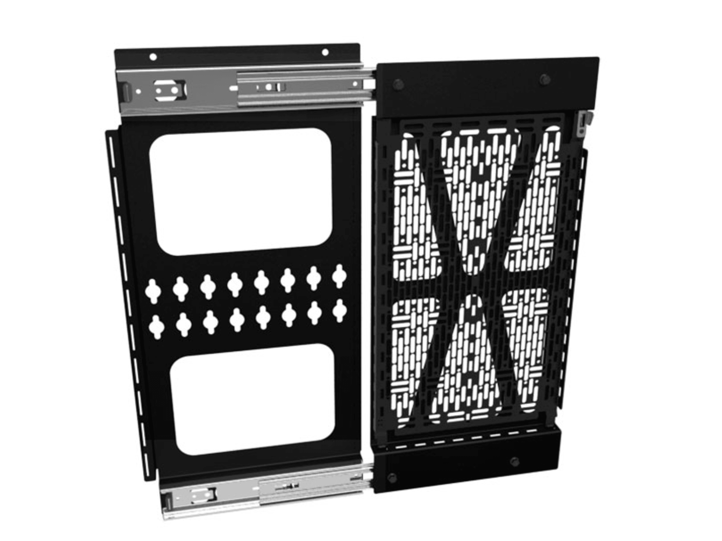
Small device storage solutions
  Proximity® Component Storage Slide-Lock Panel
  Chief part code: CSSLP15X10
  Simplify service and accessibly of small equipment with a smooth slide & lock plate
  The built-in and tool-free 25cm x 40cm Lever Lock™ plate is easily removed and replaced to service the equipment post-installation without touching the display

Slide 18
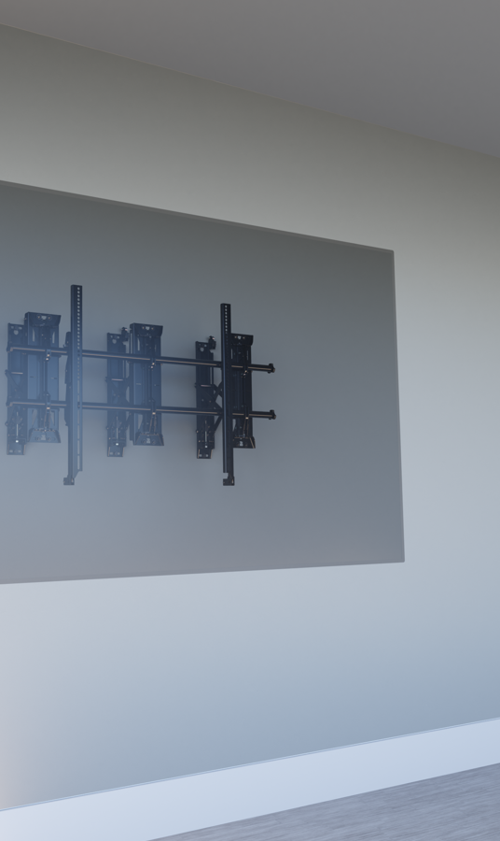
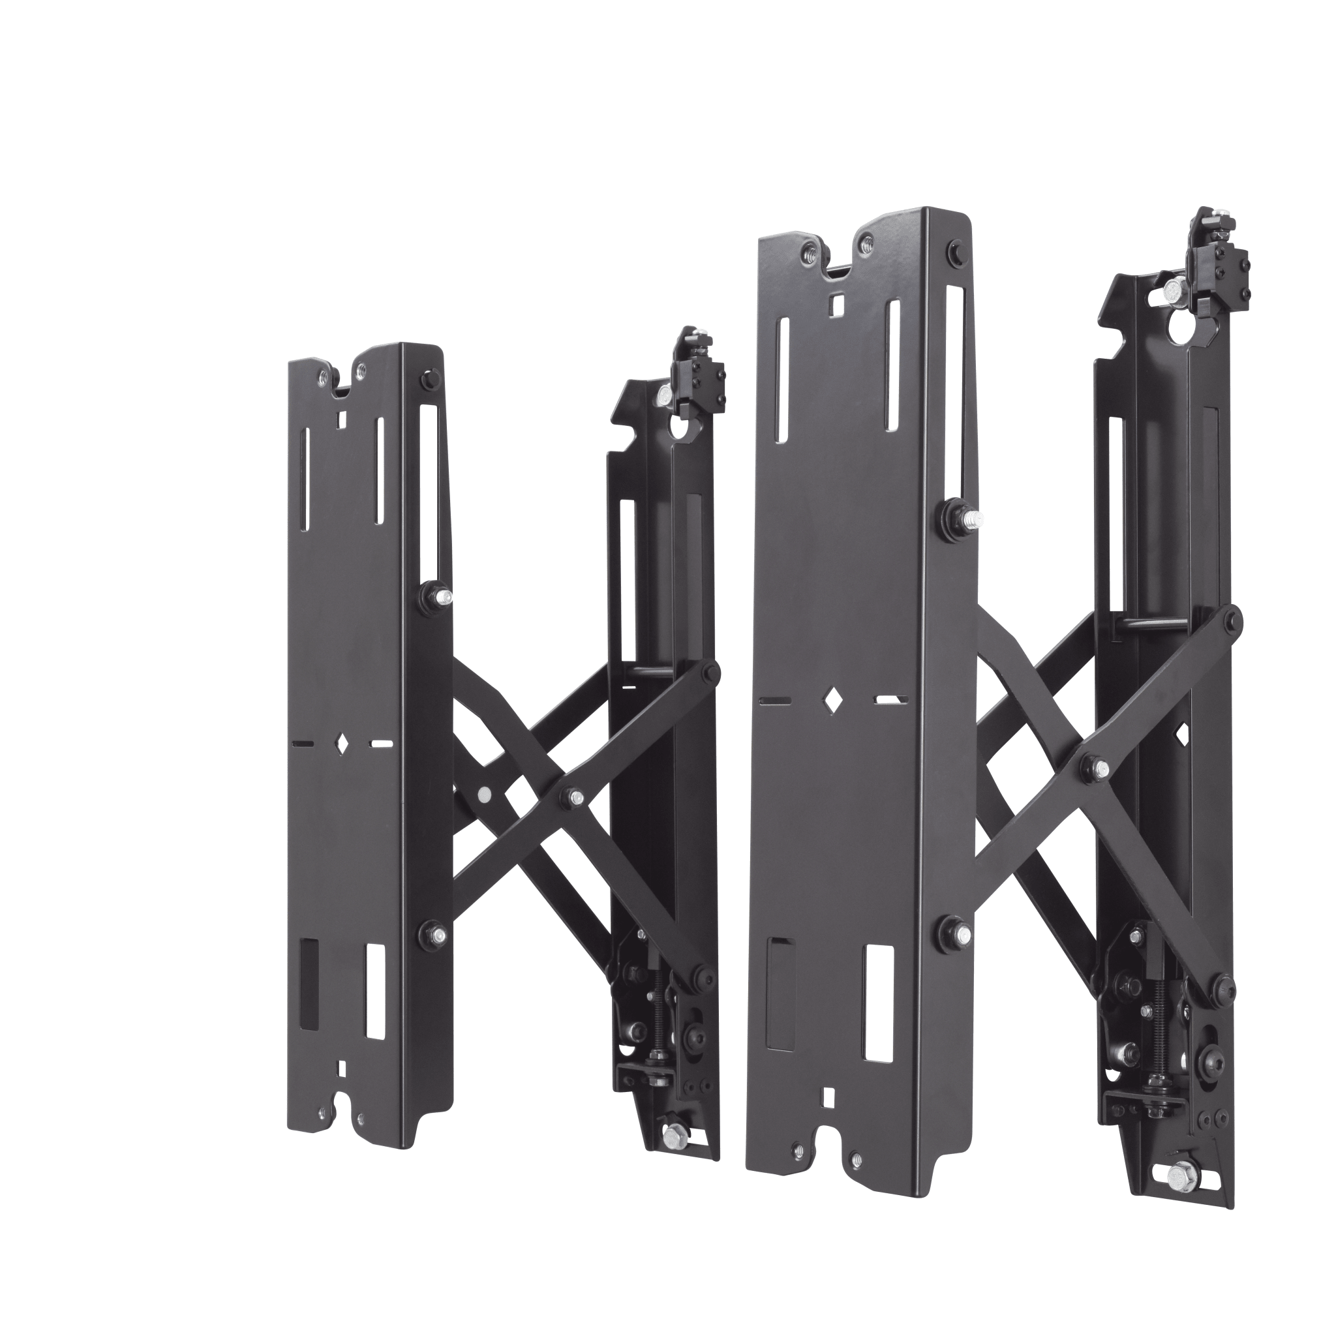
Small device storage solutions
  Fusion® Pull Out Accessory
  Chief part code: FCAV1U
  Use FCAXV1U for 80”-100’ displays
  Easily access & service stored equipment behind display using this Pull Out & Service displays

Slide 19

Multiple Small Device storage
Tempo™ Flat Panel Wall Mount System
Tempo™ Flat Panel Wall Mount System Series SKU: AS3LD

Slide 20
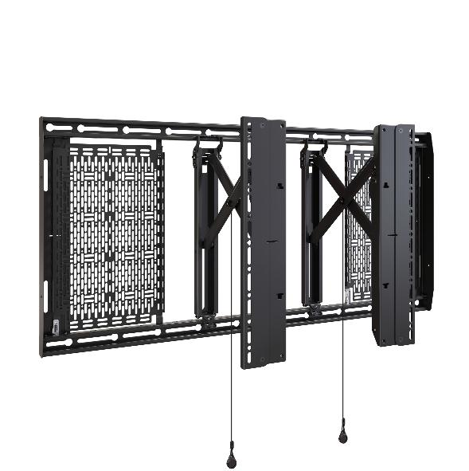
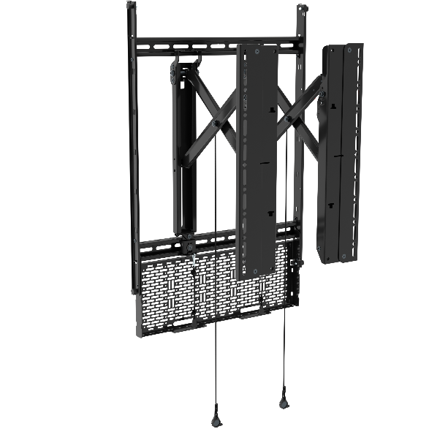
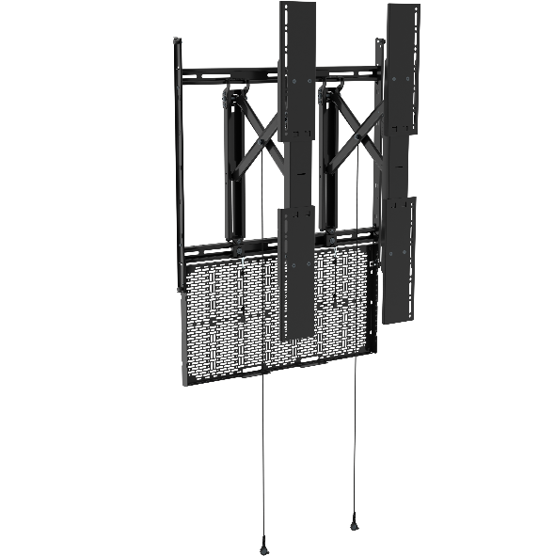
Tempo Landscape & Portrait Wall Mount
Tempo Wall Mount System (AS3LD)
Tempo Portrait Medium Wall Mount System (AS3PM)
Tempo Portrait Large Wall Mount System (AS3PL)

Slide 21
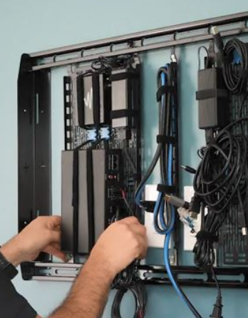
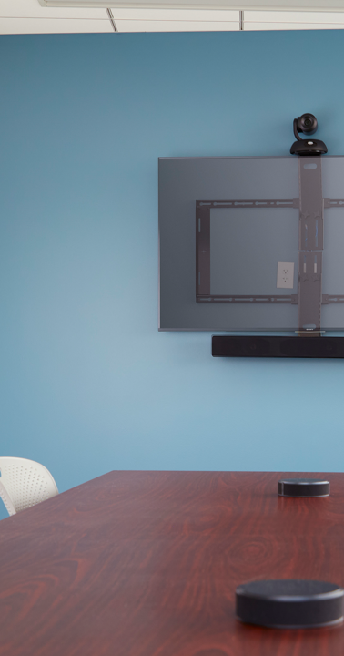
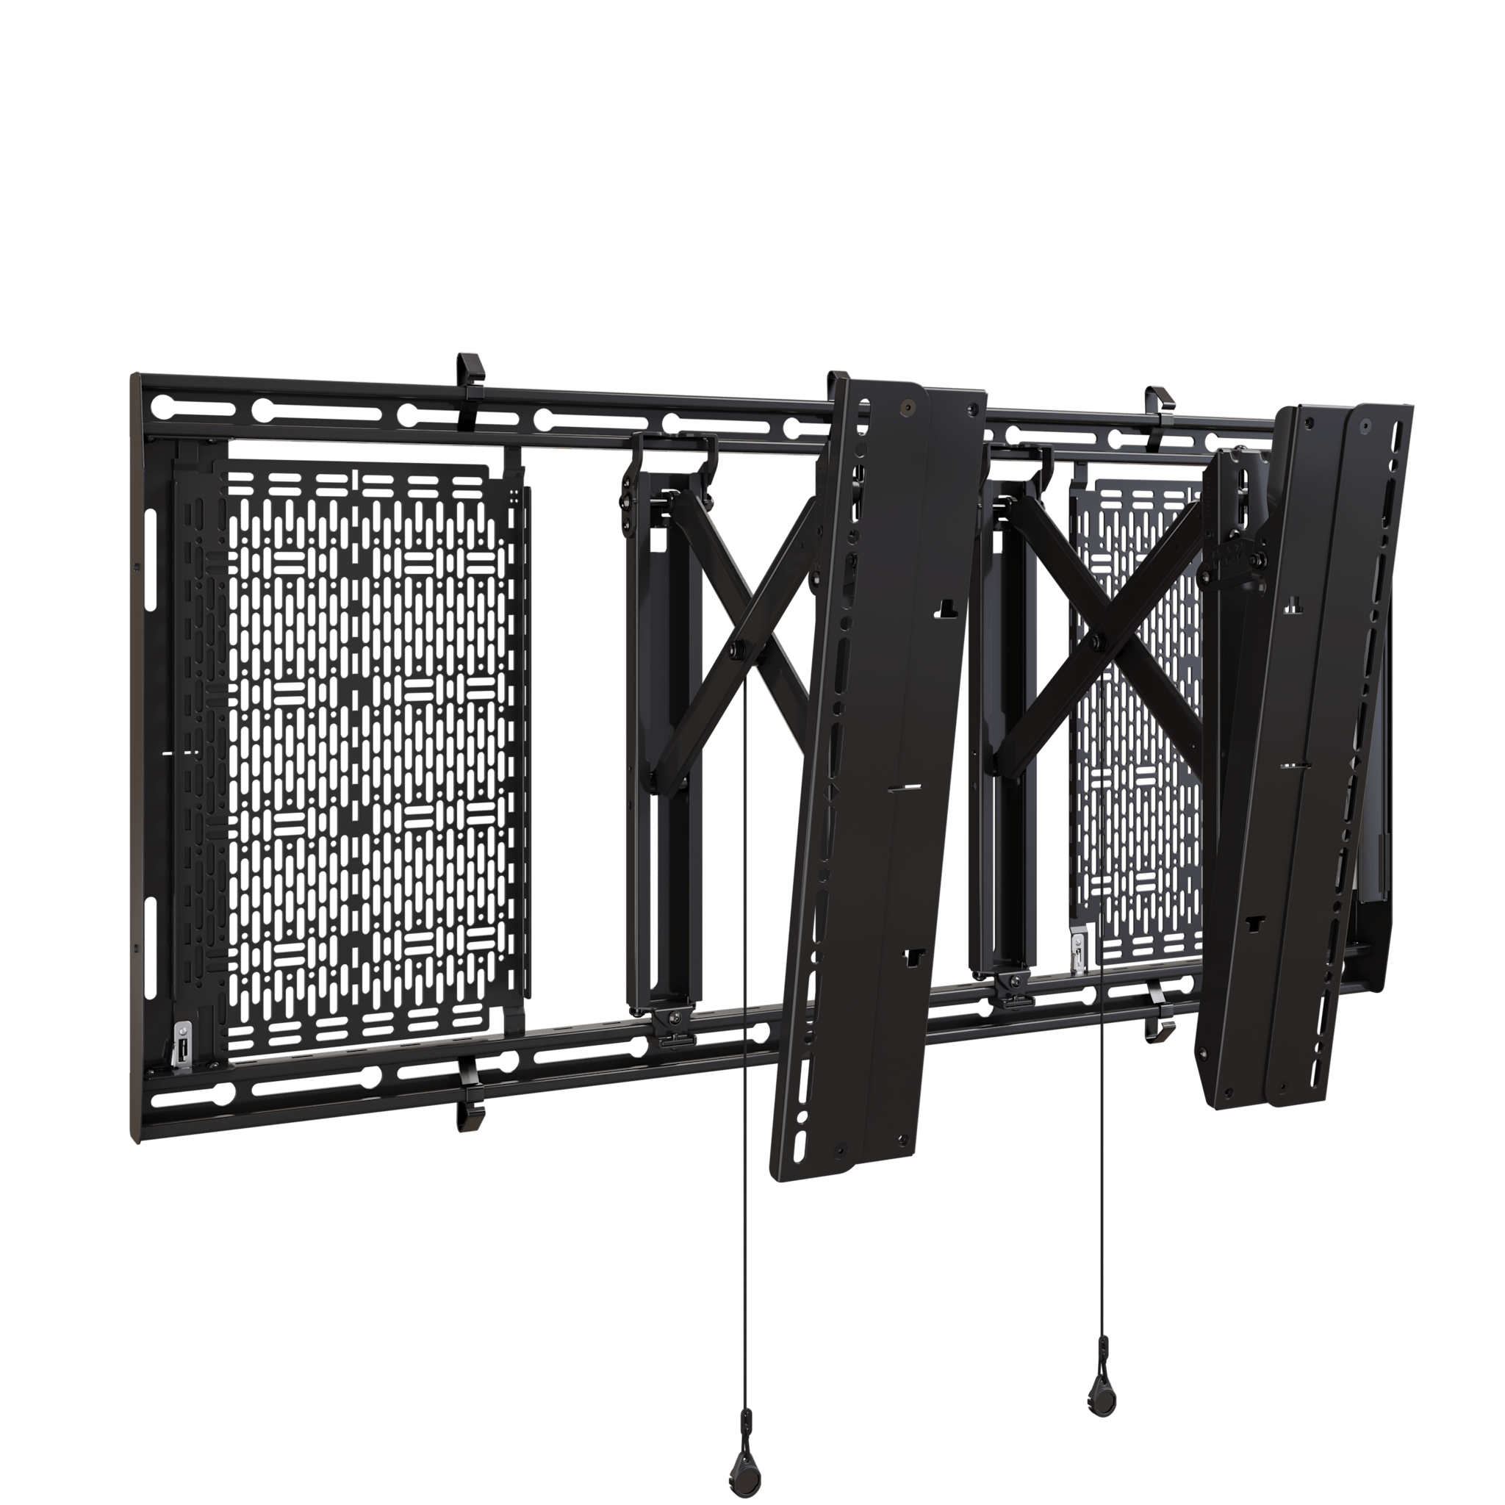
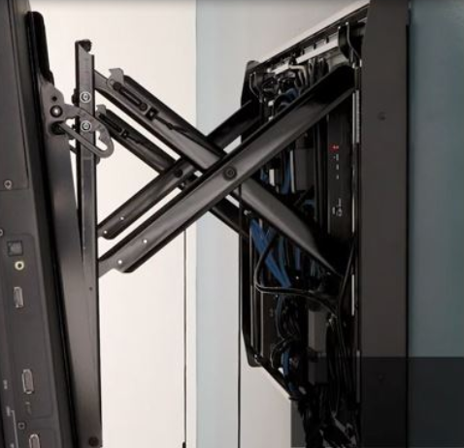
Tempo Landscape Wall Mount
Tempo™ Flat Panel Wall Mount System
  Chief part code: AS3LD
  All-in-one configurable wall mounting system that neatly stores up to six AV devices with simple, unparalleled service access.
  Includes two LeverLock storage panels
  Integrated Pull-out accessory

Slide 22

Tempo Portrait Wall Mount
Coming Soon!
Tempo™ Portrait Large Flat Panel Wall Mount System
Tempo™ Flat Panel Wall Mount System Series SKU: AS3PL
💡AS3PM: AS3 = Tempo Wall | P = Portrait | M = Medium

Slide 23


Storage Solutions
FUSION STORAGE CABINET
Fusion® Storage Cabinet
Fusion® Storage Cabinet Series SKU: FCASTC

Slide 24


Fusion Storage Cabinet
A stylish way to store AV equipment
Notes:
What’s included?
Fully assembled storage cabinet
Universal camera/videobar mount
Felt front cover
Felt cable channel
Lever Lock™ Vertical Small Device Mounting Panel
19” Rackmount brackets (pair)
Integrated security
Integrated passive thermal management
Integrated cable management

Slide 25



CHIEF FCASTC Fusion Storage Cabinet

Slide 26



FCASTC Single & Dual Displays
Rallybar Integration

Slide 27
CHIEF FCASTC Fusion Storage Cabinet
Highlights
5 Minuten Installationszeit
Frontabdeckung aus akustischem Filz
Befestigung mit Magneten
Integrierte Sicherheitsvorrichtung
Stufenlos verstellbar
Inklusive 2RU-Rackschiene mit Halterungen
Montage von 19"-Geräten
Lever Lock™-Panel
Umfasst universelle Ablage für Videokameras
Kabelkanal mit Filzabdeckung
Passives Wärmemanagement
Gewichtskapazität 30 kg
Fusion Halterungen: MSA1U, MTA1U, LSM1U, LSA1U, LTM1U, LTA1U, XSM1U, XTM1U, KITXWXSM1U

Slide 28

CHIEF FCASTC Fusion Storage Cabinet
Case Study

Slide 29

Storage Solutions
New!

Slide 30


Tempo Floor support Mount
30

Slide 31



Tempo Floor Support Mount – Transformation 2026

Slide 32


CHIEF Tempo Floor Mount

Slide 33


CHIEF Tempo Floor Mount

Slide 34


CHIEF Tempo Floor Mount

Slide 35

Forum™ Collaboration Suite
Forum™ Collaboration Suite Display Stand and Shroud
Forum™ Collaboration Suite Display Stand and
Shroud Series SKU: Select options for SKU

Slide 36




Forum™ Collaboration Suite
  Designed for open or closed hybrid workspaces
  Freestanding or Floor-to-wall in dark or light finishes
  Available with table configurations
  For Single and Dual displays up to 105”
  Integrated in Modus VR
Notes:
Forum display stand is Designed for open or closed workspaces, freestanding or floor to wall. With acoustic felt material behind the display to enhance the audio in the room.
Integrated Chief display mount for single and dual display up to 105”
There is a version with 2 doors and 3 doors with softclose system and optional locks, they have 4 RU pace in the compartments below the display and room for small device storage behind the displays with rear access.

Slide 37

Forum™ Collaboration Suite

Slide 38


Forum™ Collaboration Suite
Notes:
All in all, a great solution for Hybrid collaboration in open and closed spaces with lots of AV storage space and design options.
You can check out the product page on the website and configure your display stand in the configurator.

Slide 39
Storage Solutions
C3 Credenza
Frame for C3 Wood Kit

Slide 40





C3 Credenza Series
  Middle Atlantic C3 configuration page
  Technical furniture with extensive rack and thermal management options
  Vertically rackmount equipment
  Custom & Pre-configurable options
  C5 series for deeper horizontal credenza configurations

Slide 41

C3 Credenza Series

Slide 42

Accessories
Notes:
I will keep repeating it, installer inspired design! That’s the Chief brand motto, but I must admit, we do it with all our brands, also at MAP.
We integrate chief mounts into MAP products and the other way around, we integrate MAP products into Chief mounts.
These small blue clamps, you’ve seen these across the whole presentation, during the videos. These are called Forward small device clamps and Tie Saddles. They are compatible with all the Proximity and leverlock panels that are integrated in all our storage solutions.
You can use Zip ties or other ways to attach the devices to these plates, but there are some advantages for these forward clamps:
Faster installation compared to other solutions
No other hardware is needed to attach or remove them, just pop them in and twist them for half a turn and they are attached.
They are re-usable
Use different kinds of clamps for different purposes.
Soft rubber pads protect your devices from scratches
And they look cool ;P
Minimum order quantity is 4 pieces, up to 60 pieces in a jar.
NEXT SLIDE

Slide 43

Dedicated Legrand AV Storage Landing Page
Storage Solutions for All Spaces | Legrand AV

Slide 44

Thanks.
Guido Kratzenberg
Senior Business Development Manager DACH
2026

